Slide 1
Innovations in Reducing Incarceration
Special Topic Symposium
NAMI National Convention
Washington D.C.
June 30, 2017

Slide 2

Creating a Statewide Medication Formulary
The Rx Follows the Patient:
Patrick K. Fox, MD
Chief Medical Officer
Colorado Dept. of Human Services

Slide 3


Creating a Statewide Medication Formulary
The Rx Follows the Patient:
Patrick K. Fox, MD
Chief Medical Officer
Colorado Dept. of Human Services

Slide 4

The Problem:
Lack of consistency in available medications across systems of care
Notes:
Occurs irrespective of insurer, affects youth as well as adults, as well as those with an I/DD.

Slide 5
What is currently happening?...

Slide 6
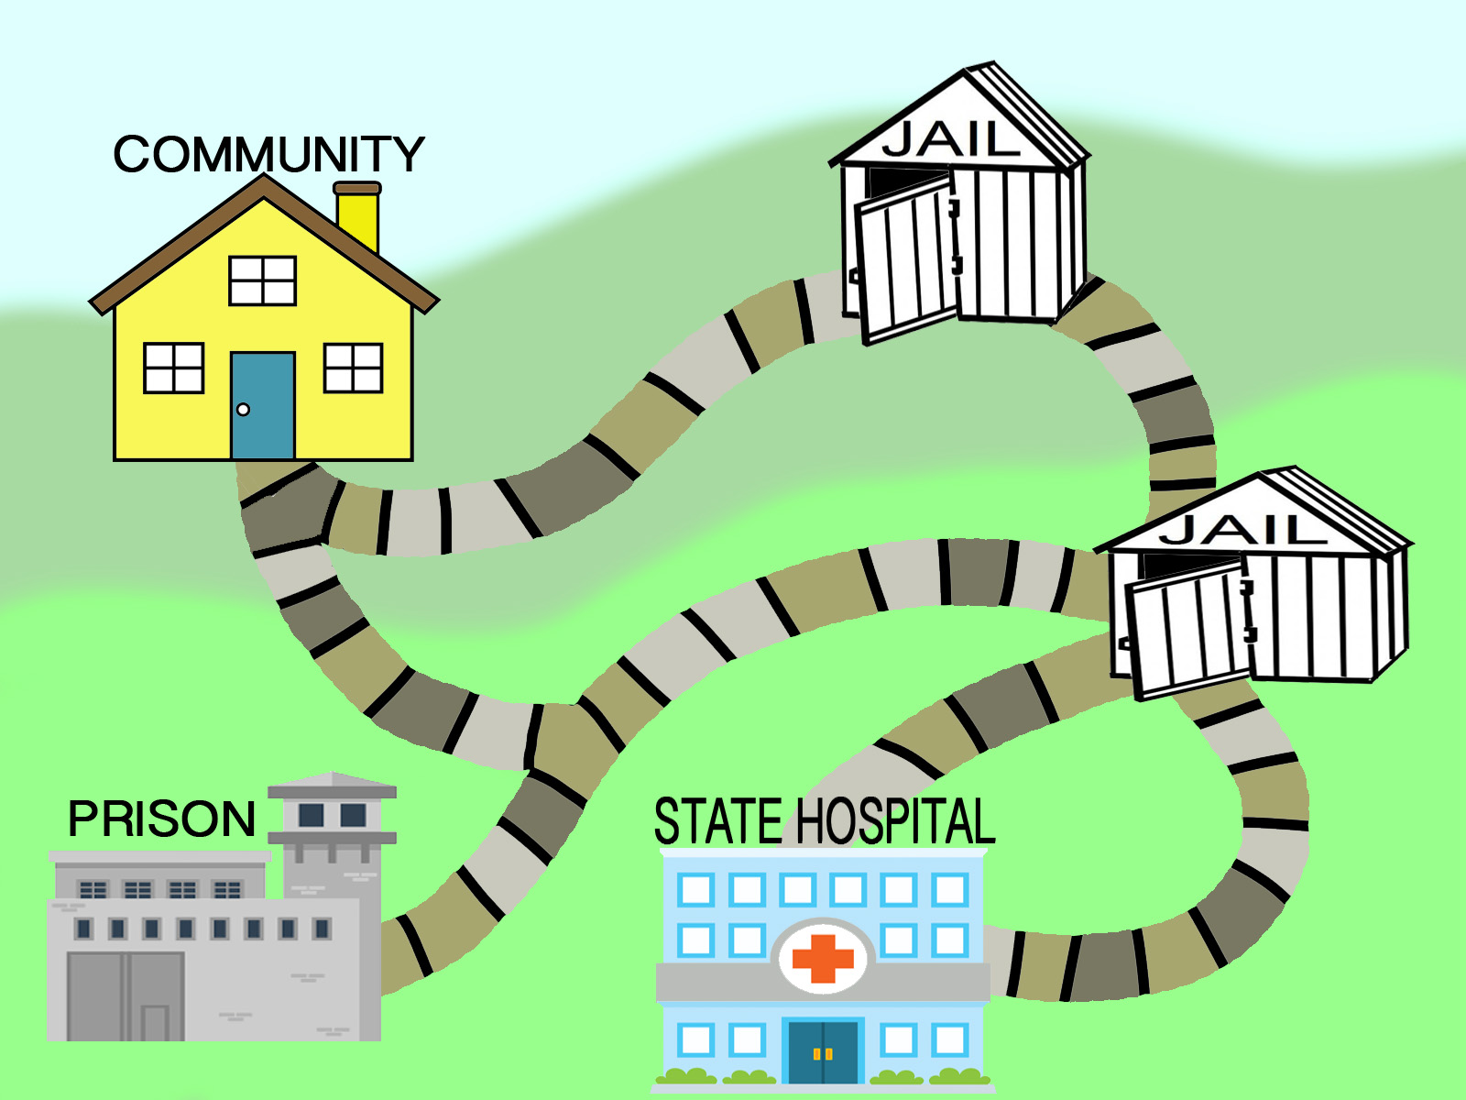
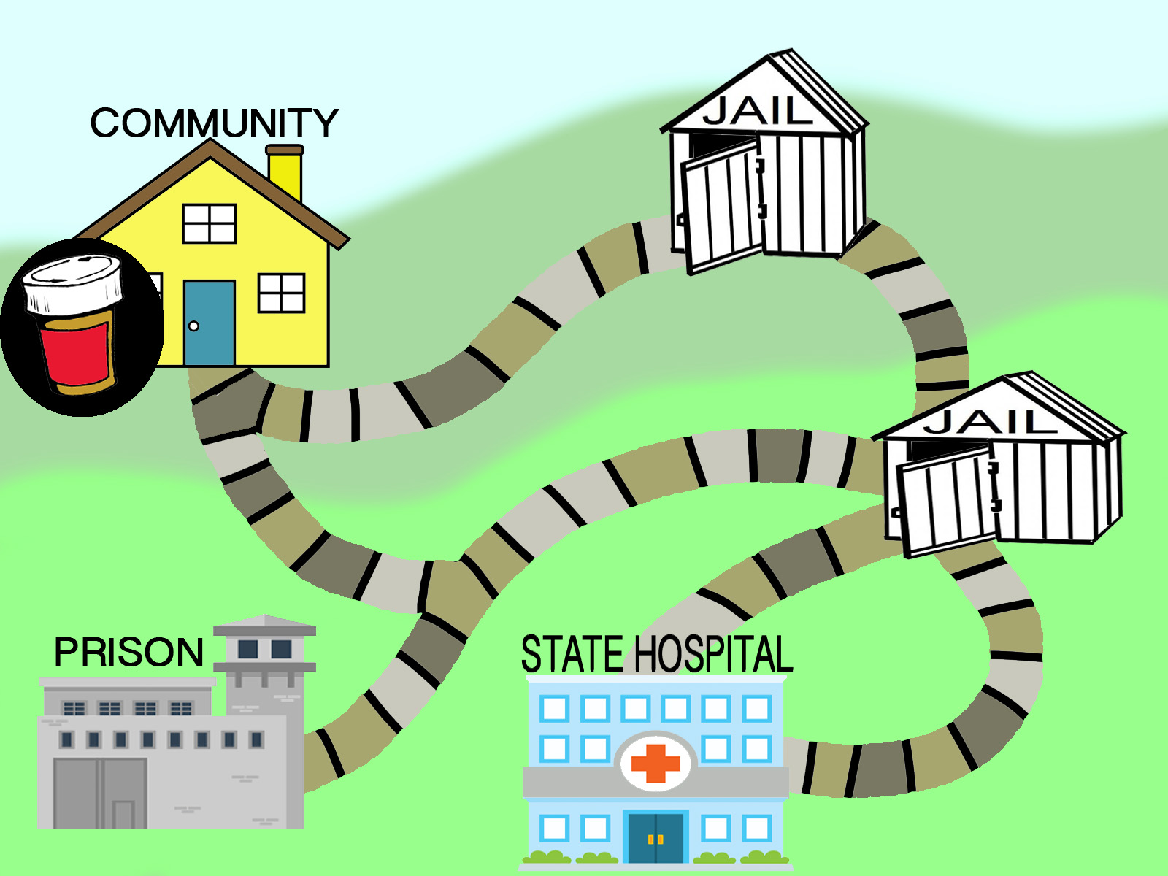
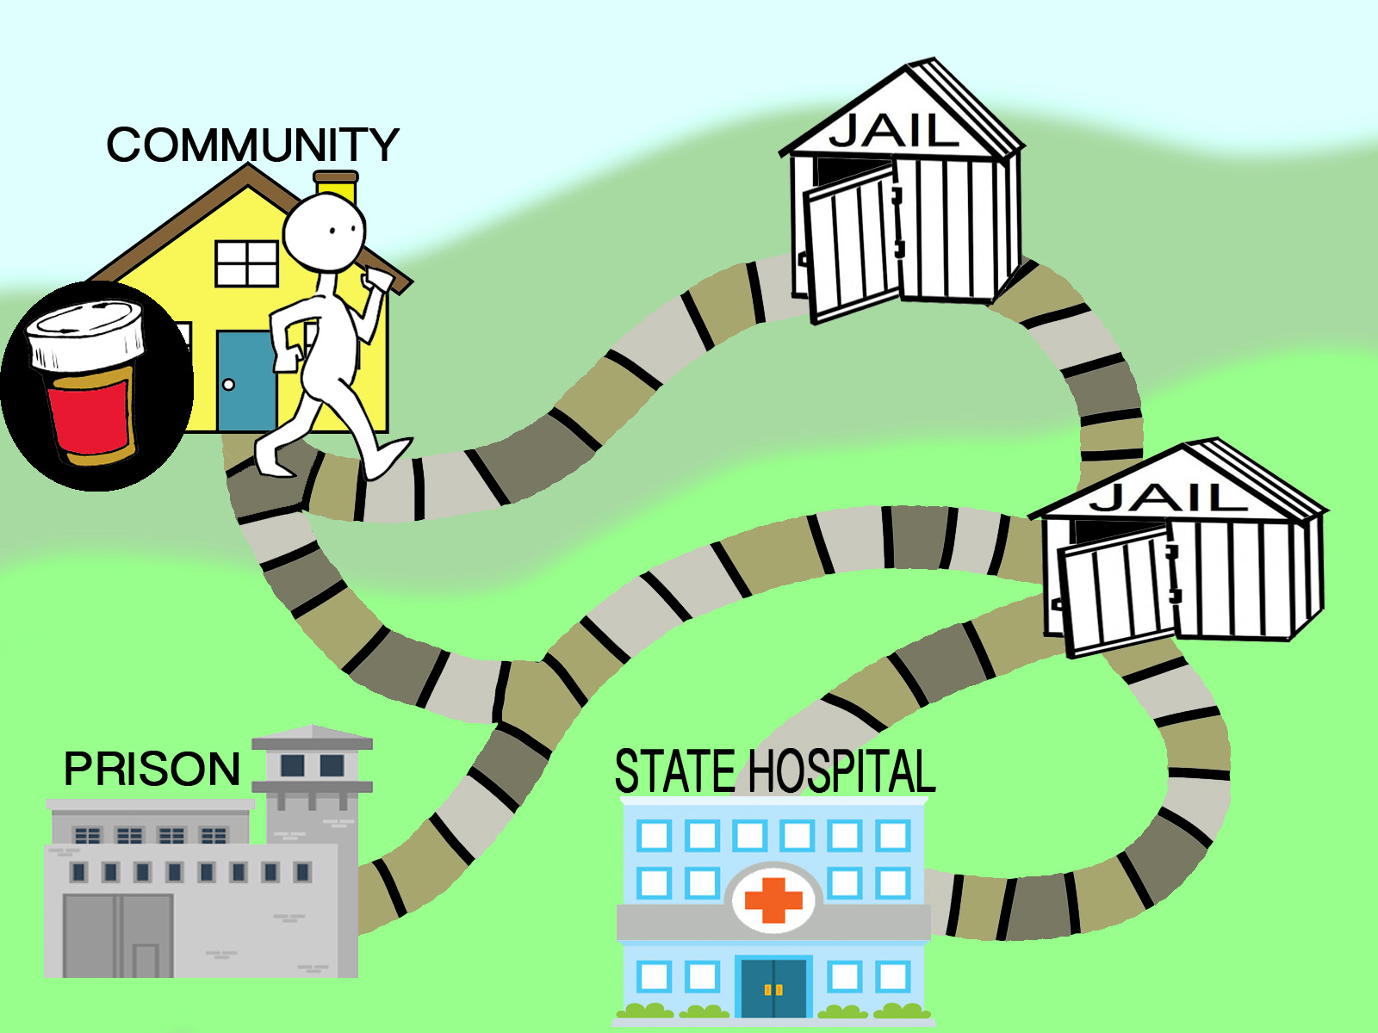
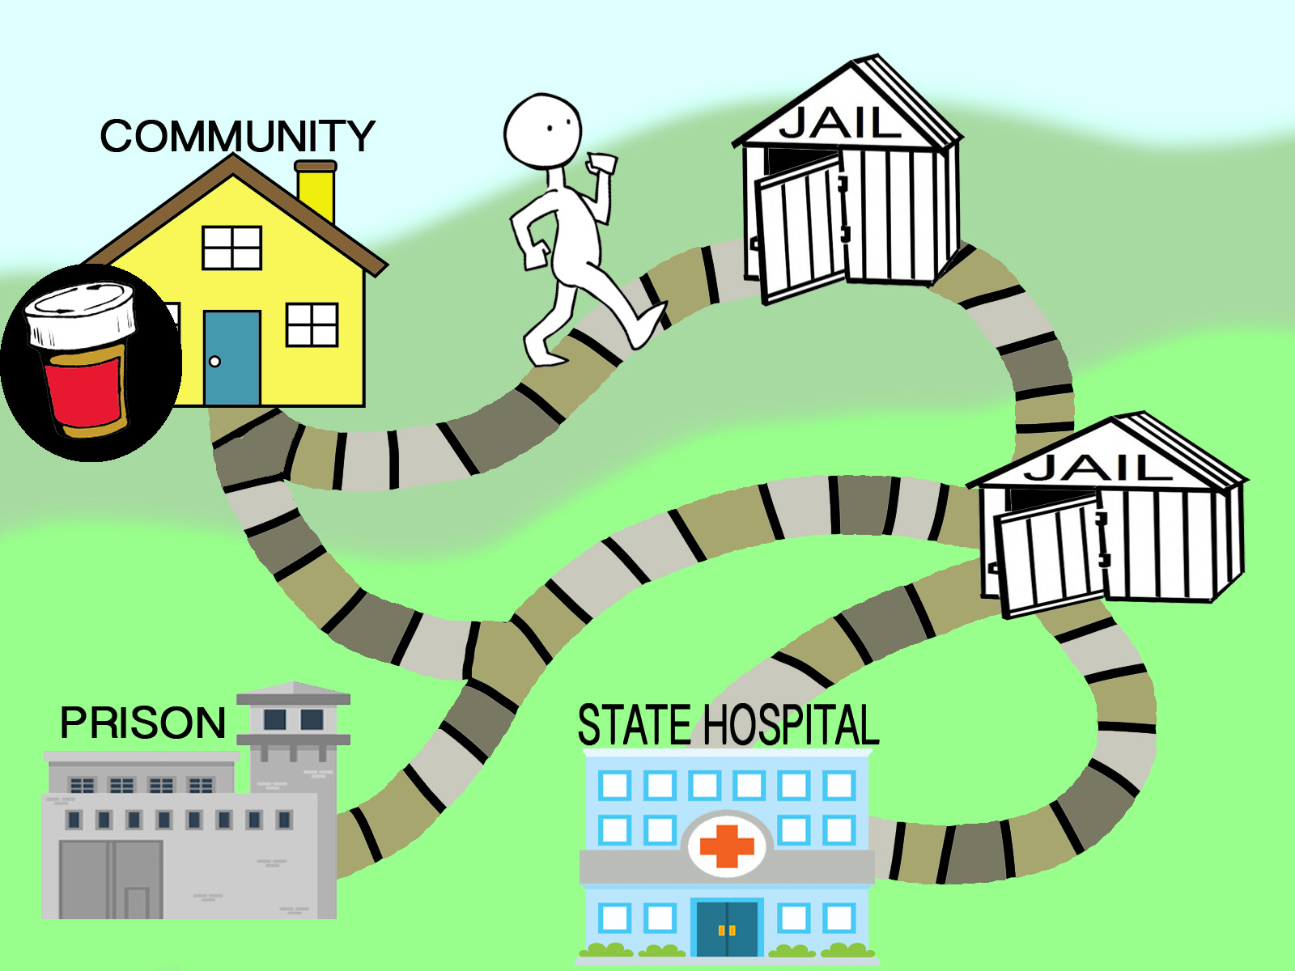
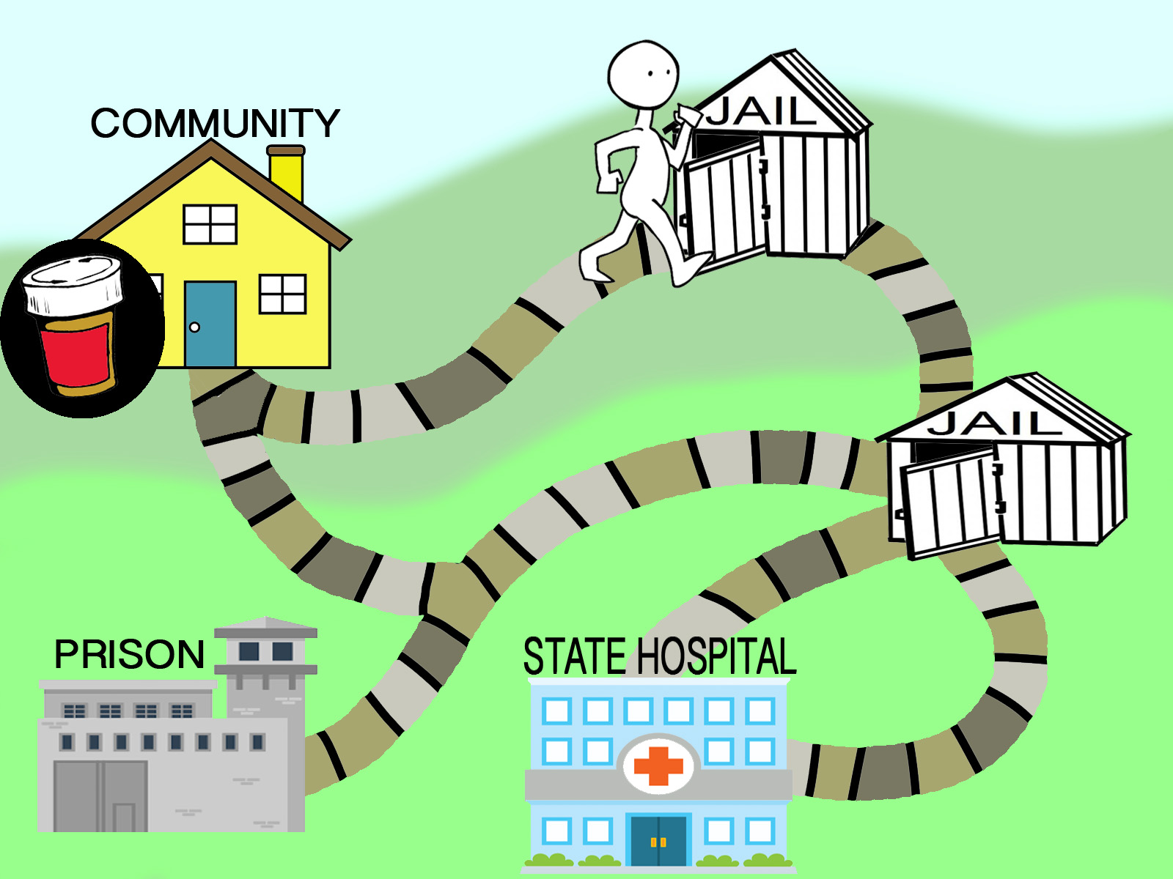
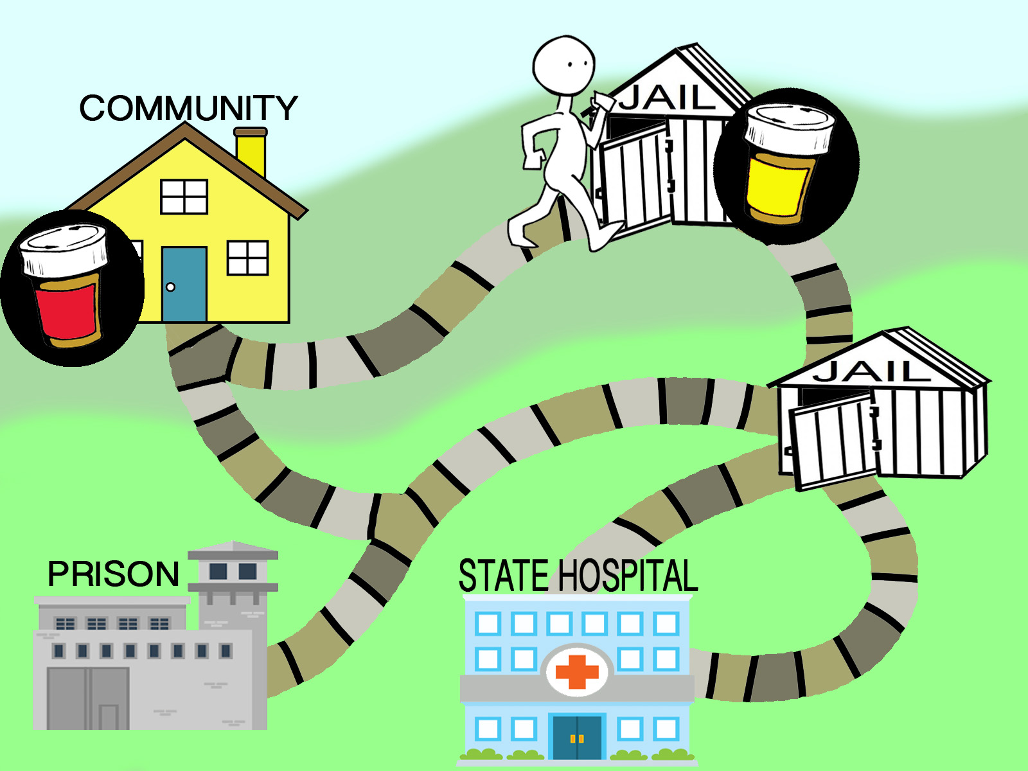
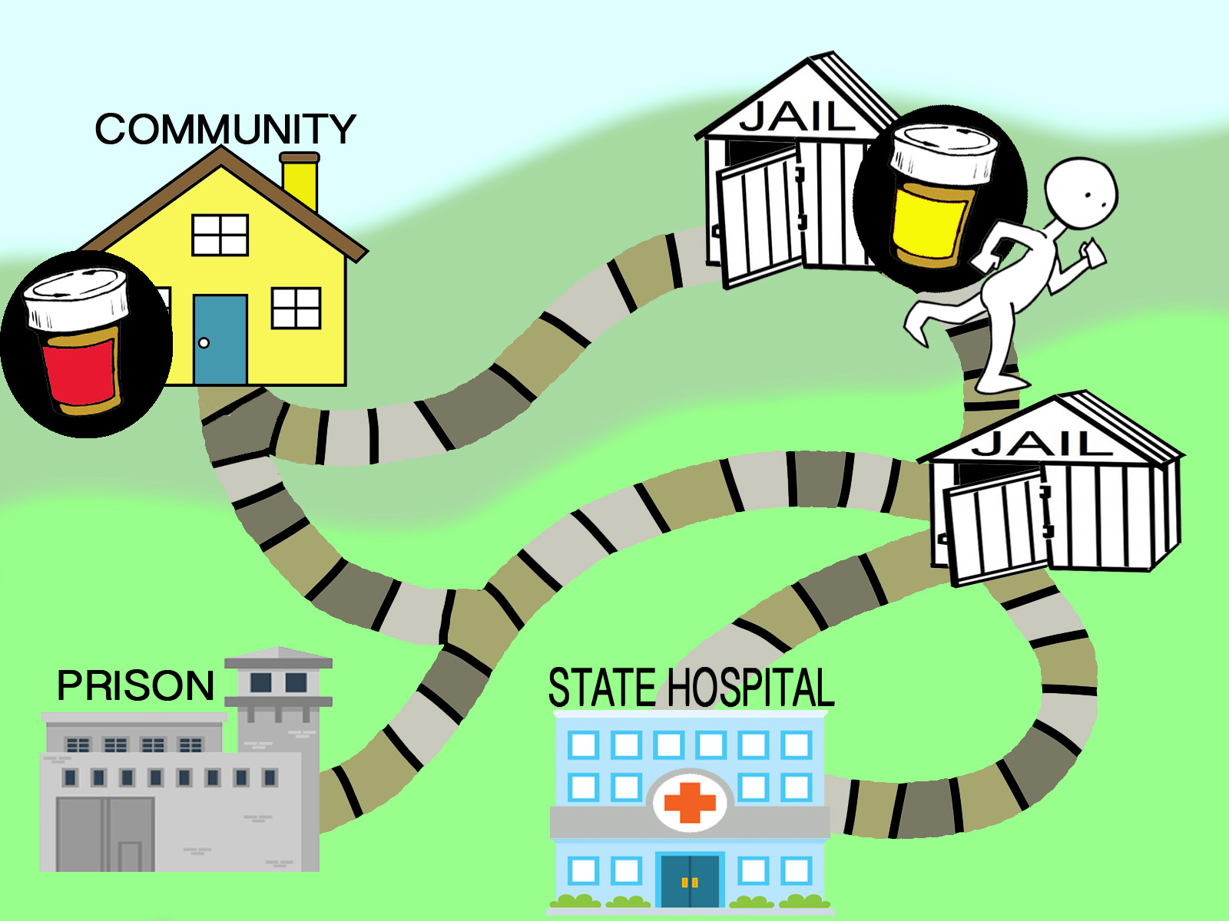

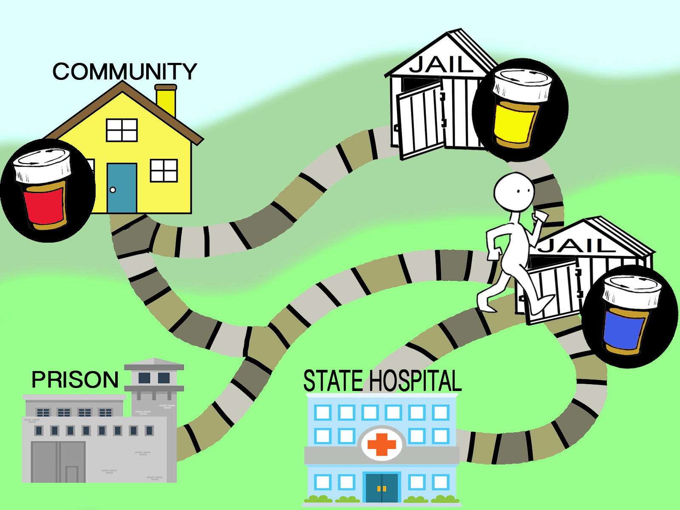
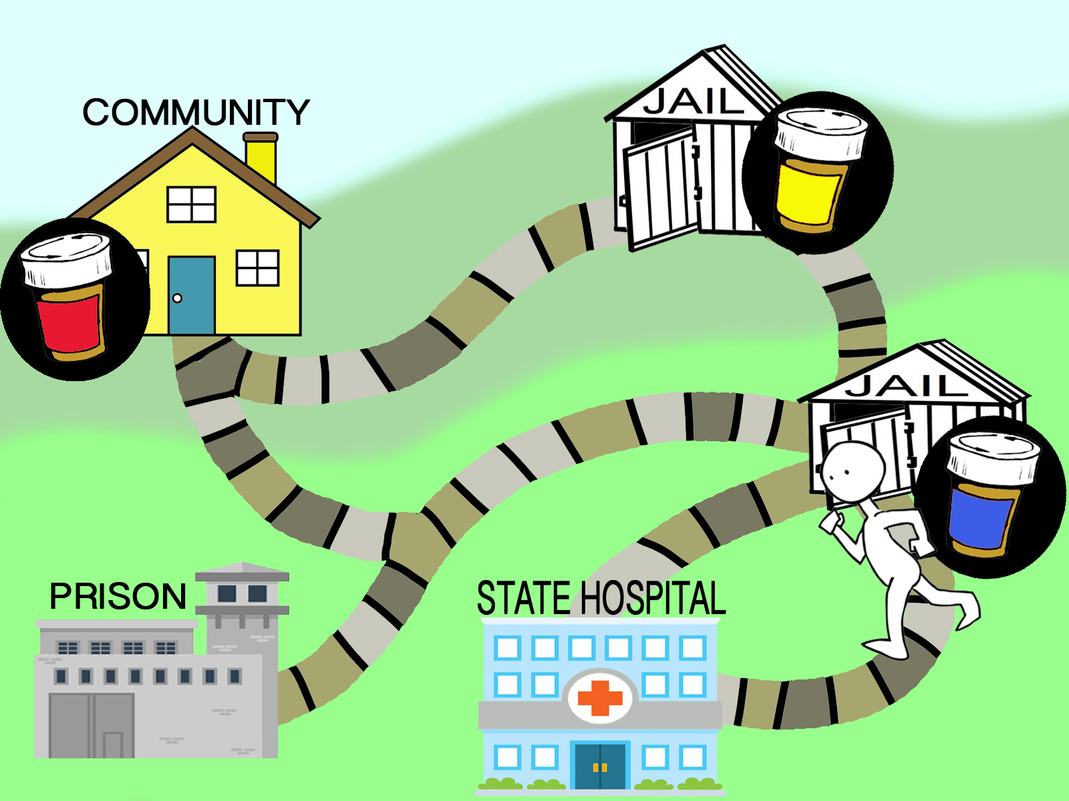
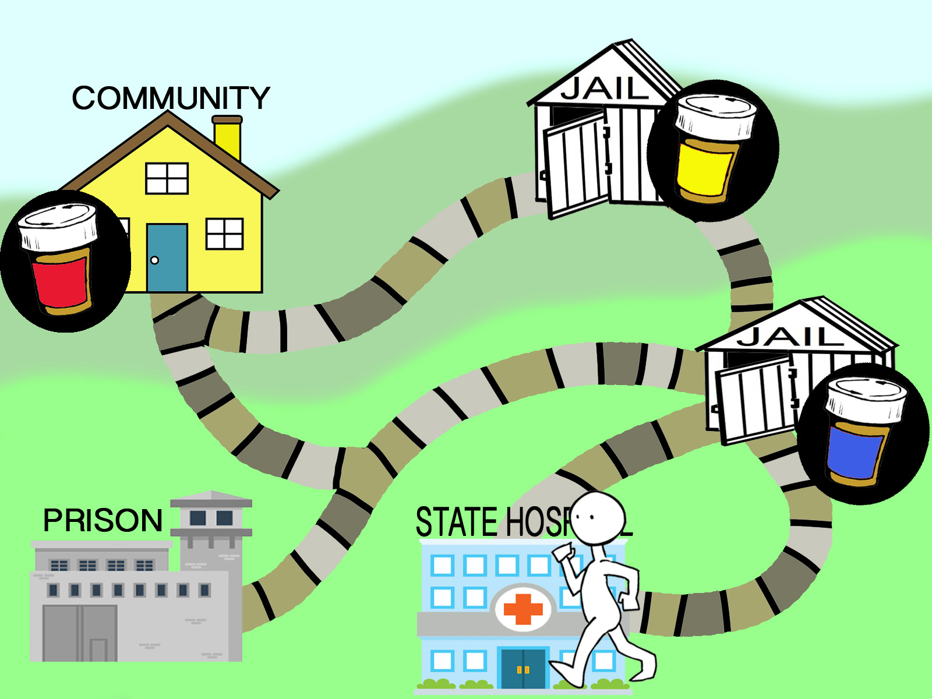
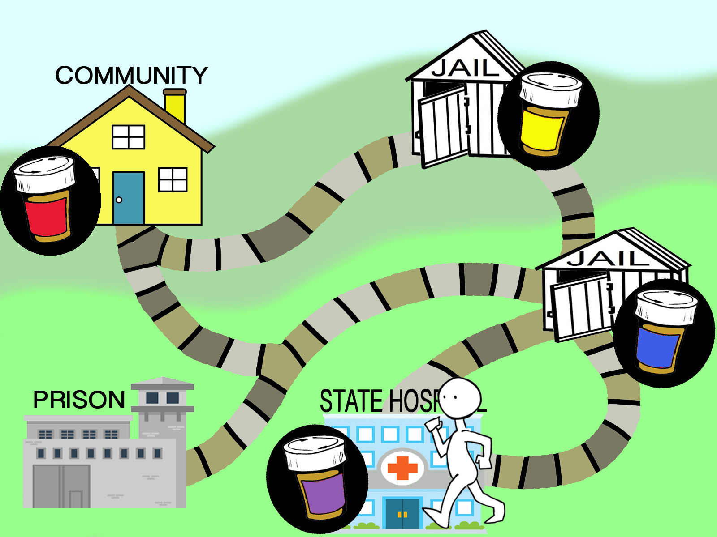
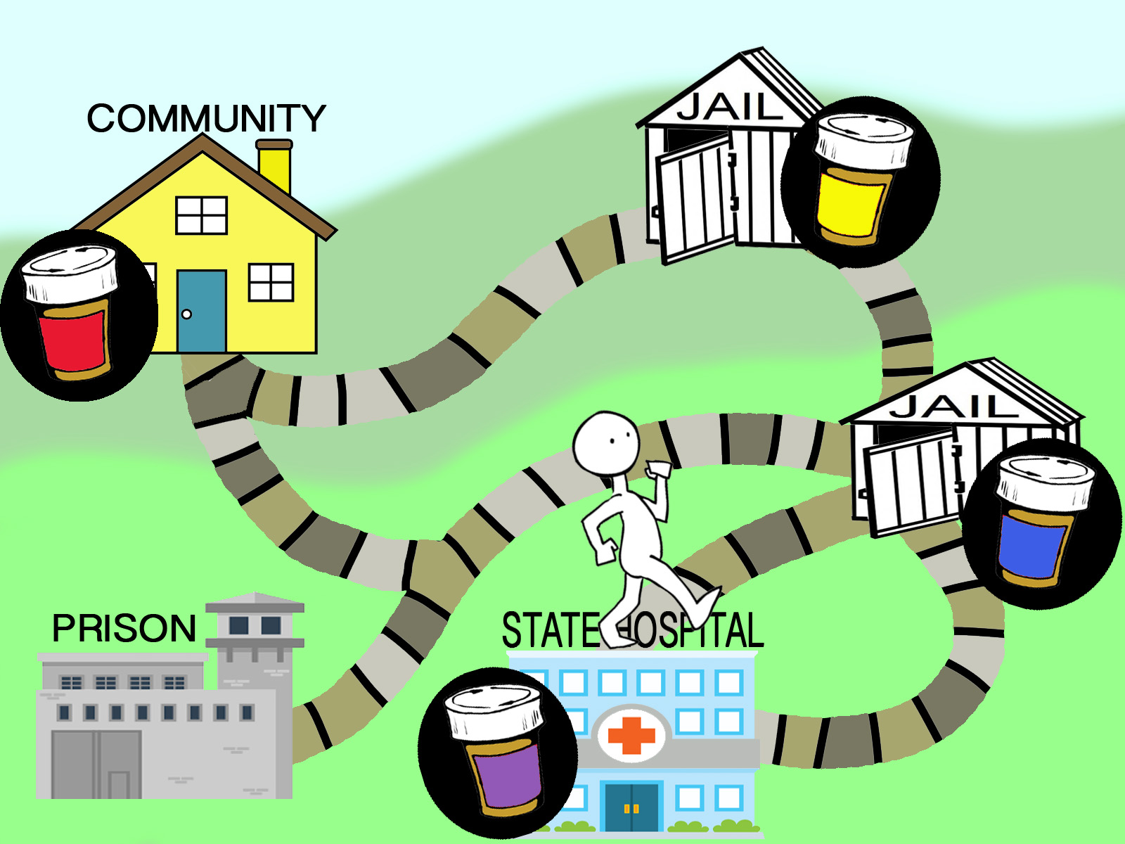
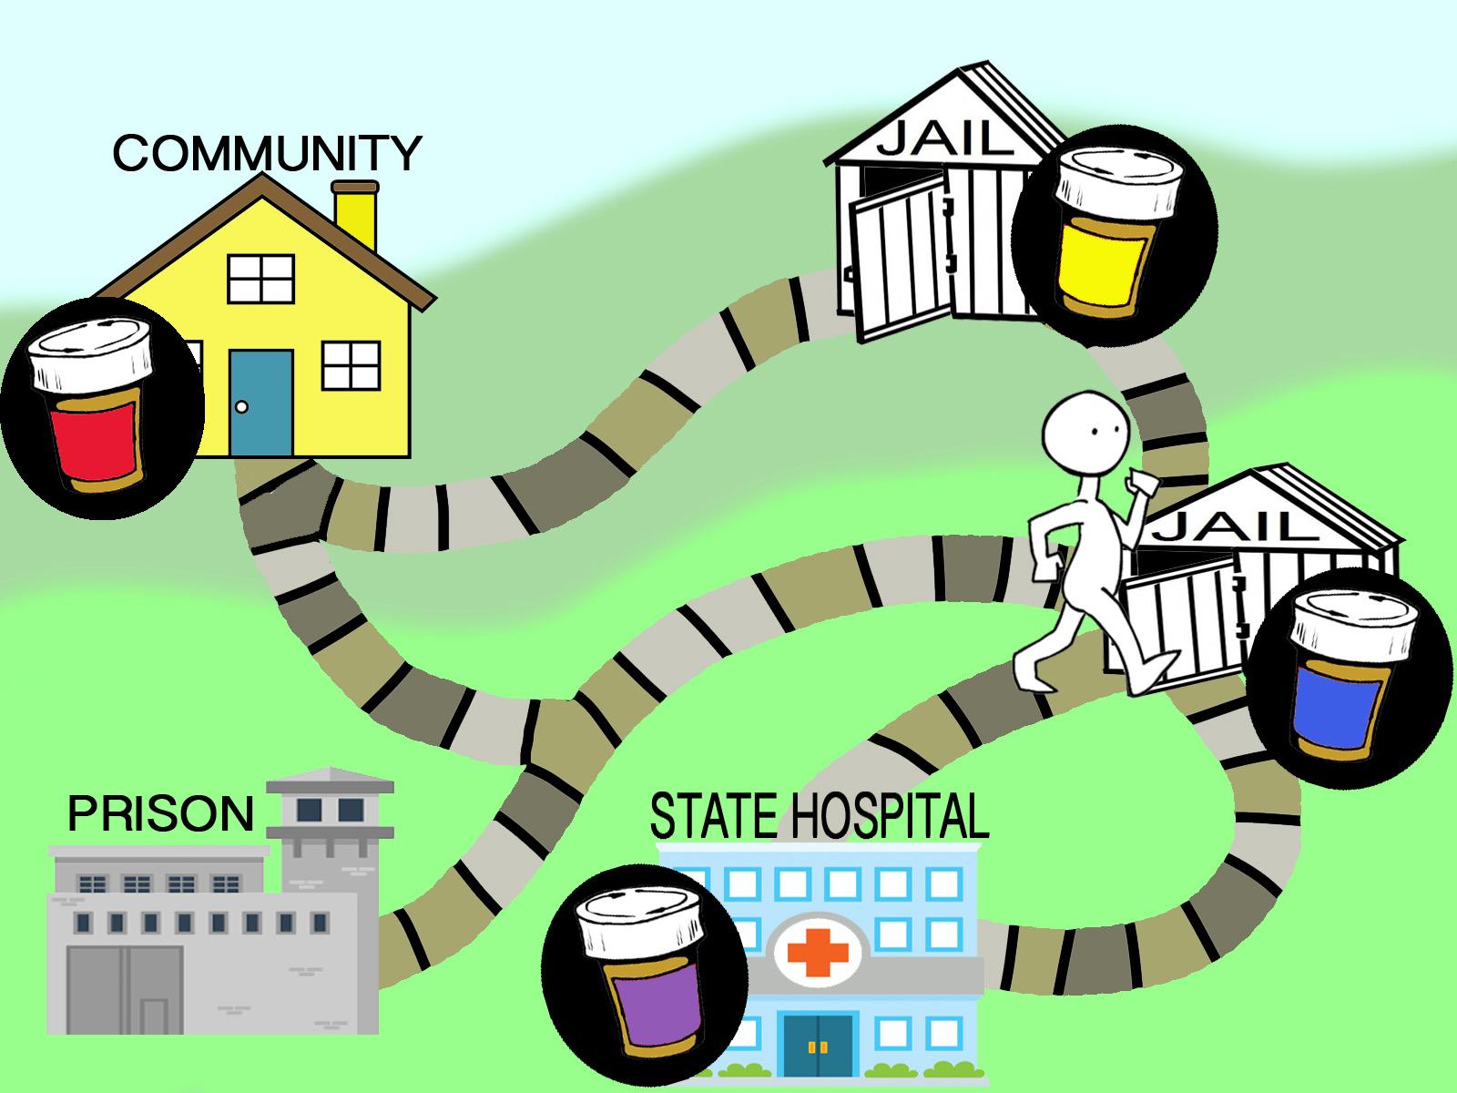

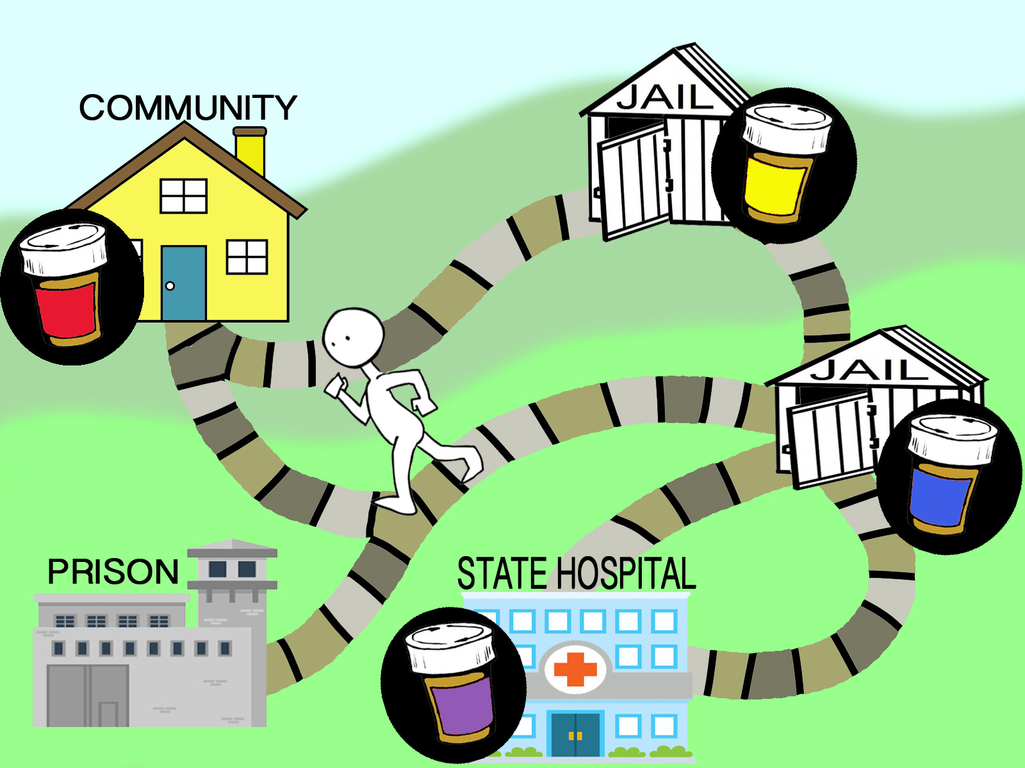

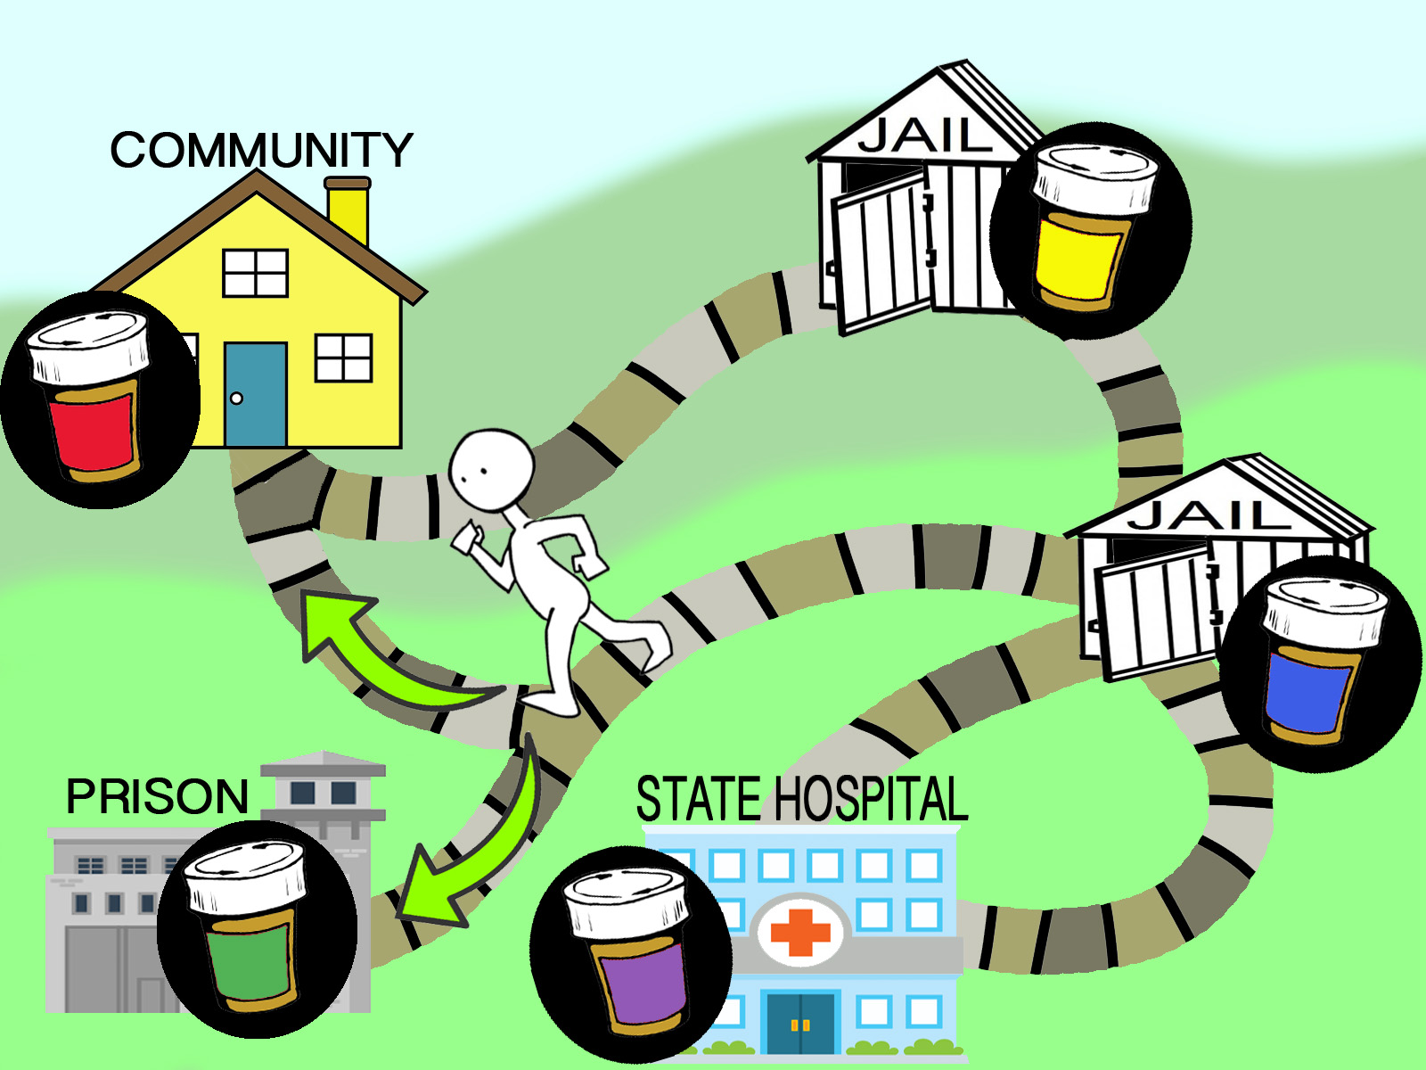

Slide 7
Why Is It Happening?
Lack of unified commitment to med consistency
Cost containment
  sample meds/vouchers for patients at reduced pricing
Ease of pharmacy administration
Facility-centric view of the issue
  Facility-based prescribing guidelines
  Prescribers opting to Rx meds that are familiar to them

Slide 8
Why It Matters
Medication consistency improves patient outcomes
Rapid discontinuation of psychotropic meds can lead to withdrawal symptoms and acute exacerbation of illness
A med that is discontinued and later restarted may be less effective
Increased societal/personal costs due to clinical instability
Anathema to the triple aim:
  improve patient outcomes
  improve patient experience
  contain/reduce costs
Notes:
Ascher-Syanum H, Faries DE, Zhu B, et al. Medication adherence and long-term functional outcomes in the treatment of schizophrenia in usual careThe Journal of Clinical Psychiatry [2006, 67(3):453-460]
Non-adherence is associated with poorer functional outcomes, including greater risk of psychiatric hospitalizations, use of emergency psychiatric services, arrests, acts of aggression, poorer mental functioning and increased substance use
Copied directly from the MHA website: Restrictive Formularies/Preferred Drug Lists
In the early 1990s, states used drug formularies (lists of medications) to limit Medicaid beneficiaries' access to medications. Many of these formularies contained only one or two mental health medications and rarely did they include the newest or most effective drugs available. In 1992, federal guidelines made it illegal for states to impose such "closed formularies," requiring Medicaid programs to make available all Federal Drug Administration (FDA) approved medications to enrollees.
Formularies are now called preferred drug lists (PDLs), but the term's definition remains unchanged; a PDL is a list of medications that consumers can access. A physician who wishes to prescribe medications that do not appear on the PDL (or formulary) must obtain prior authorization from the Medicaid agency (or its subcontractor) to allow the patient to obtain the drug medications through the Medicaid program. As a rule, a Pharmacy and Therapeutics Committee (P&T) or another workgroup is responsible for developing the list of approved medications. Theoretically, Medicaid consumers have access to all FDA-approved medications, but in practice, program administrators can make it difficult for people to access this broad choice of drugs. The provider must prove that the medications in the PDL aren't effective or have intolerable side effects for the patient in order to justify their request for a non-PDL-listed drug.
Clozapine lacks previous clinical efficacy when restarted after a period of discontinuation: a case series.
Grassi B¹, Ferrari R, Epifani M, Dragoni C, Cohen S, Scarone S.

Slide 9
What should happen...

Slide 10
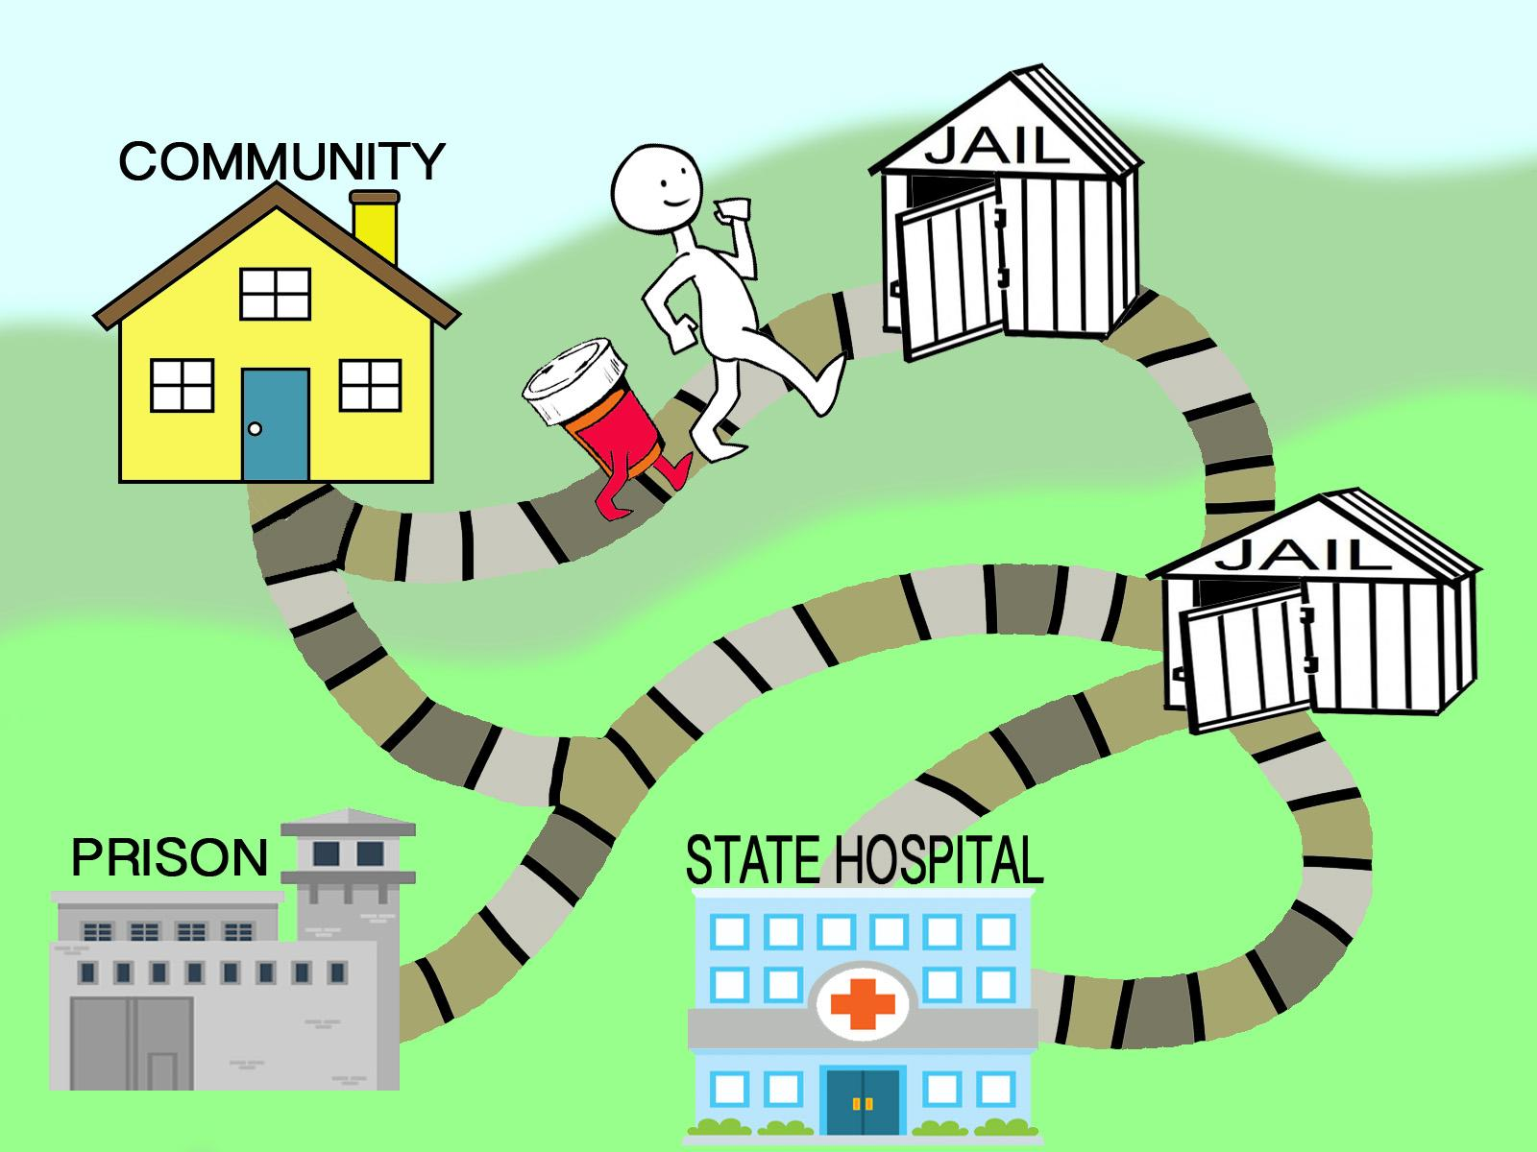
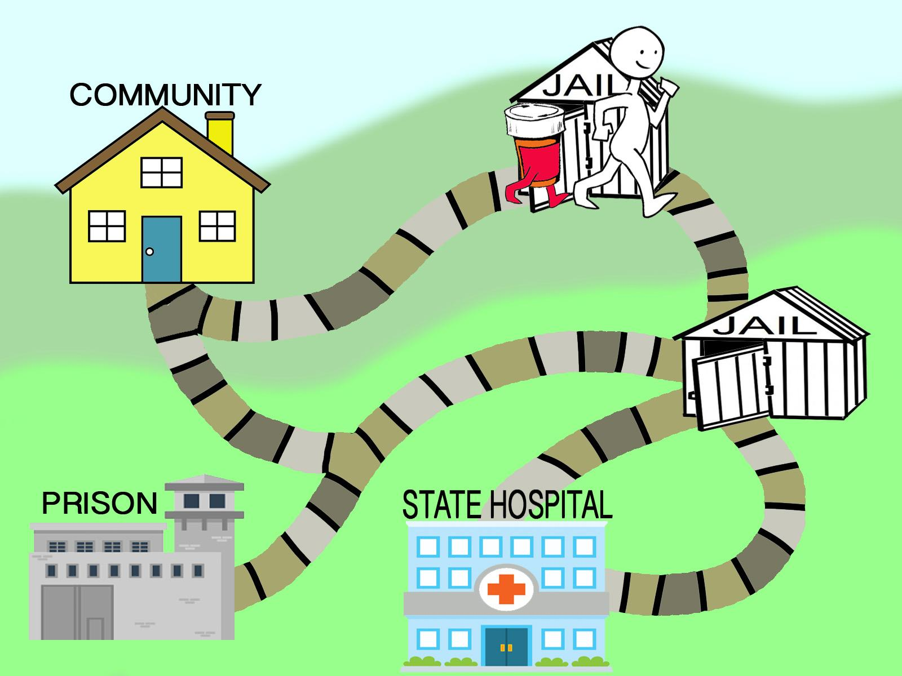
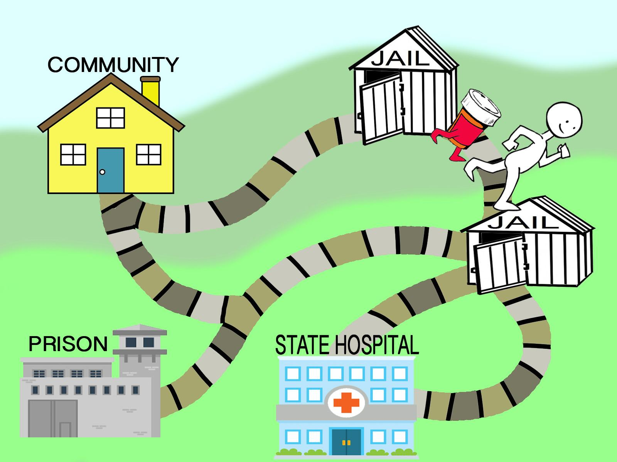
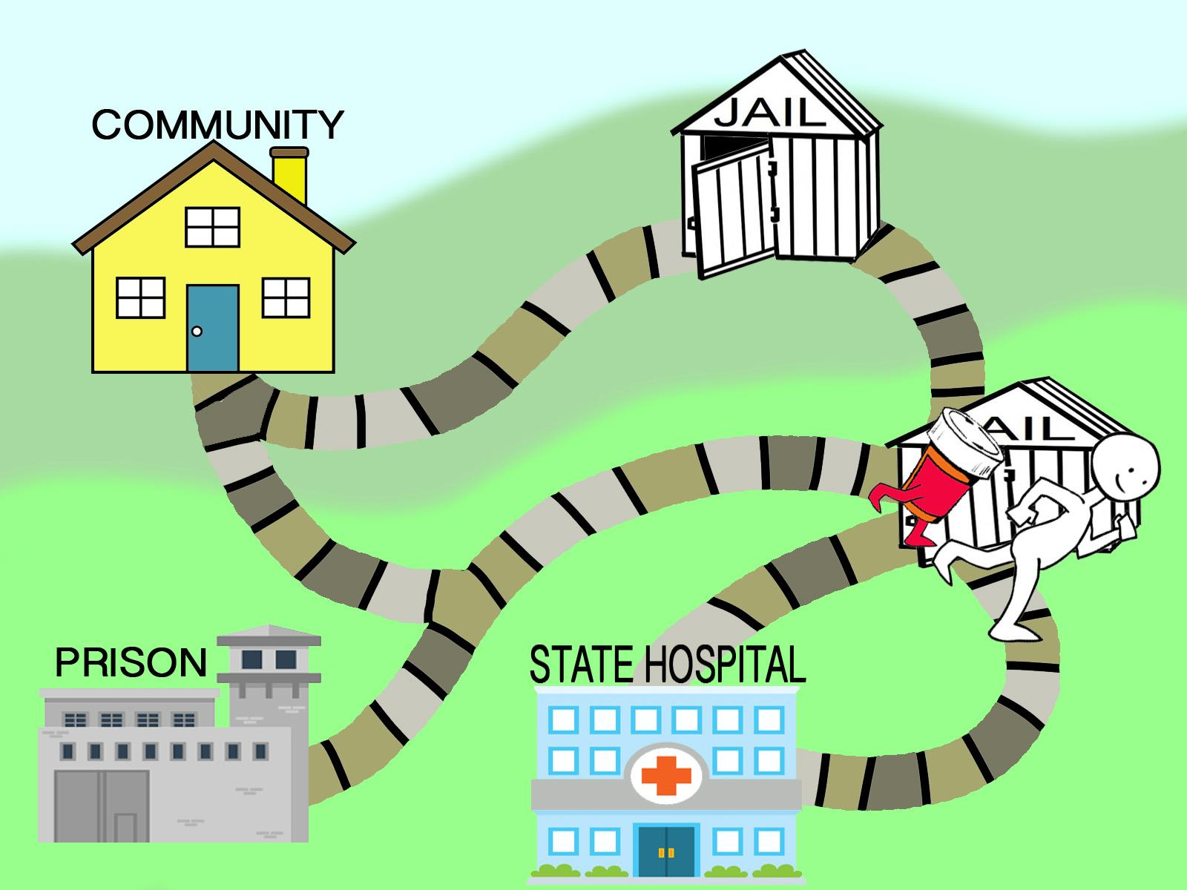
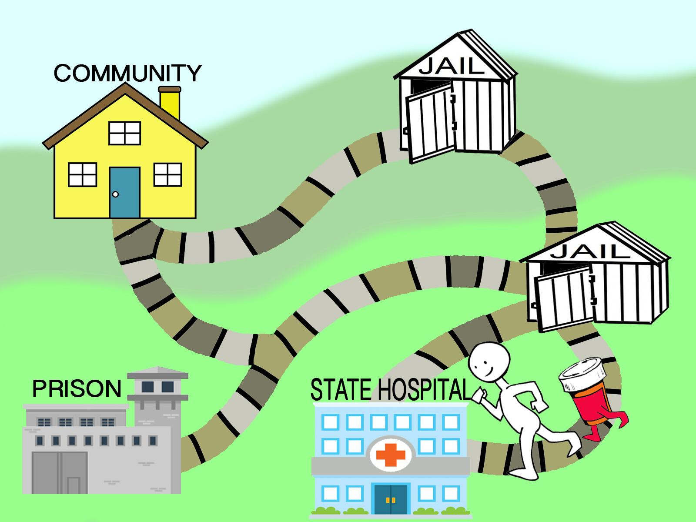
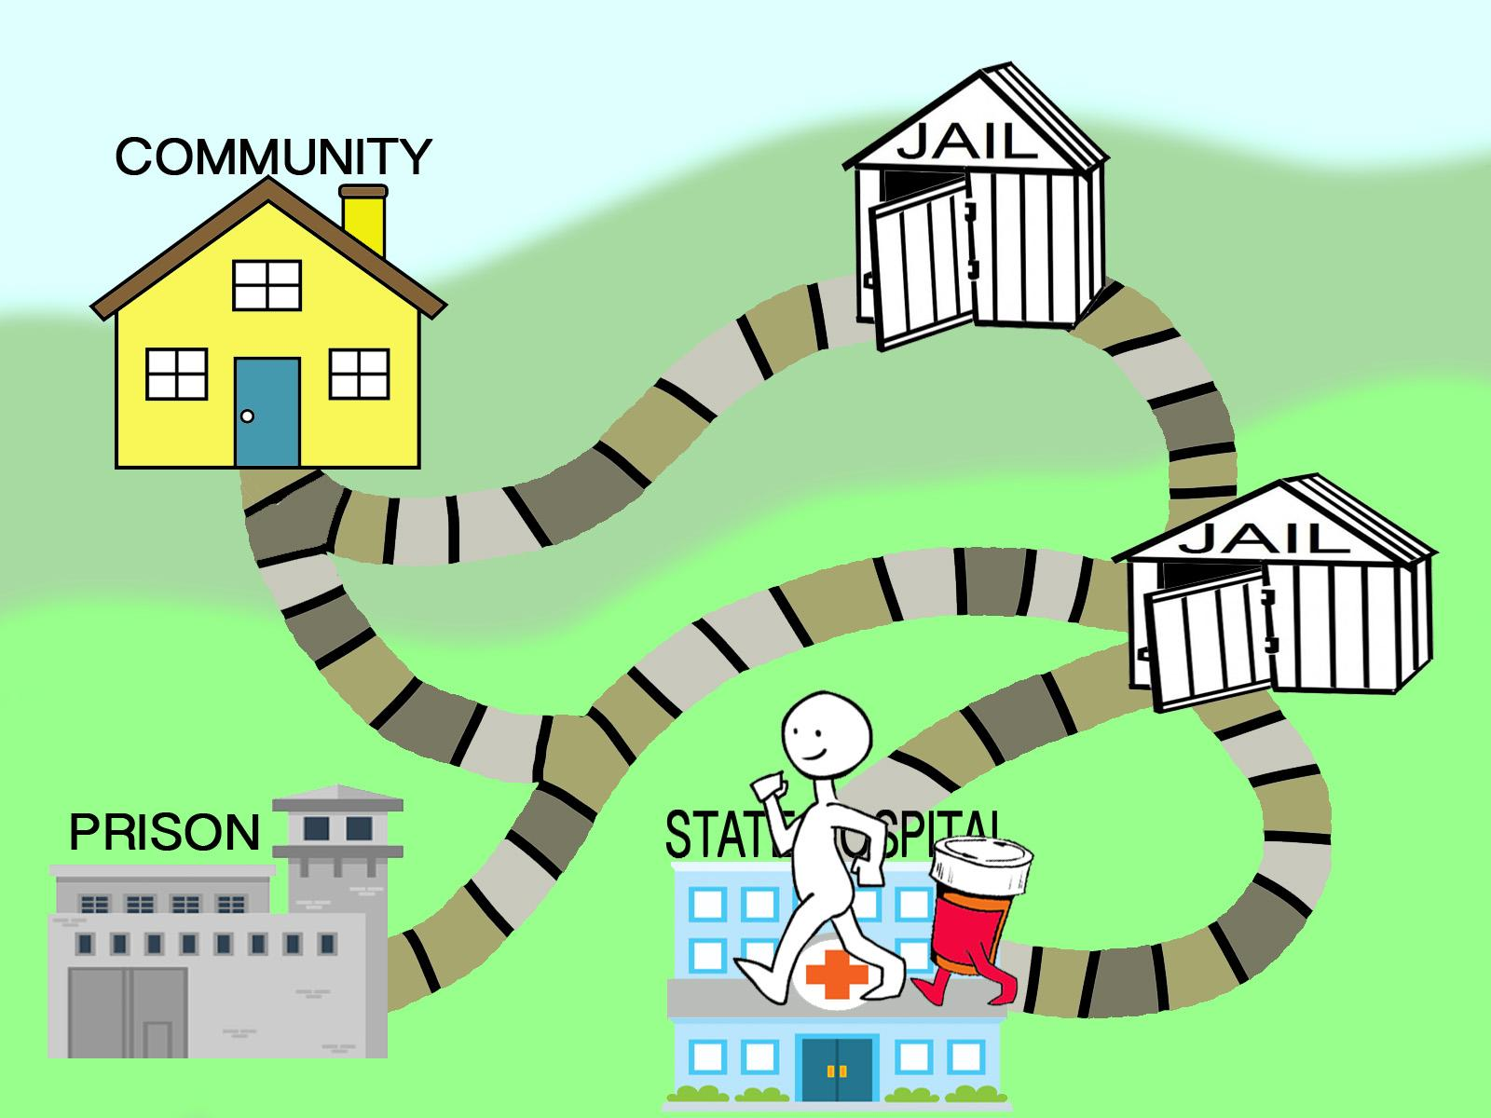
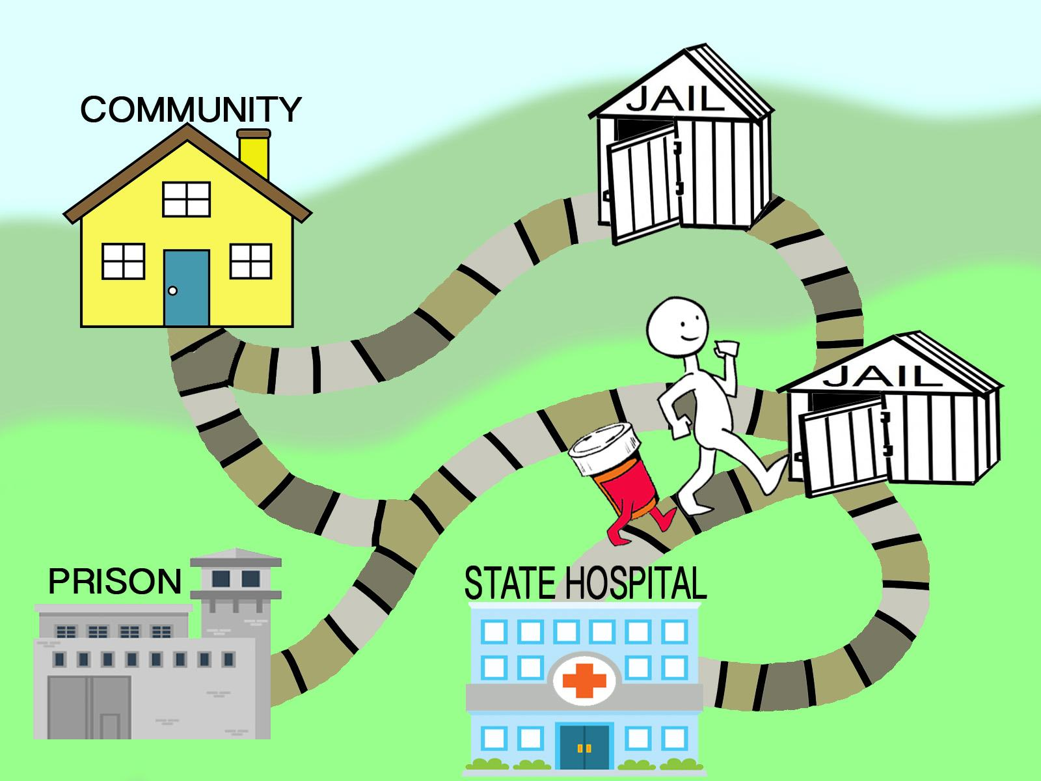
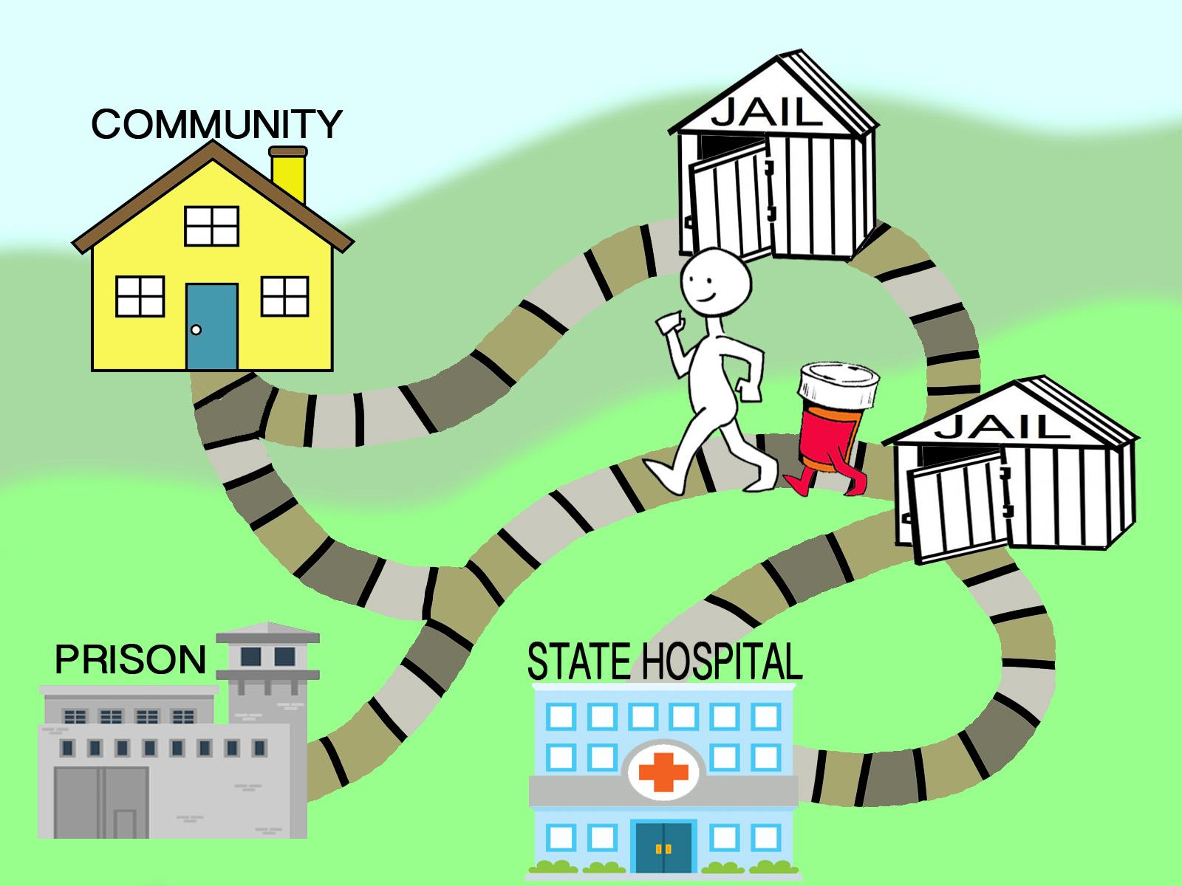
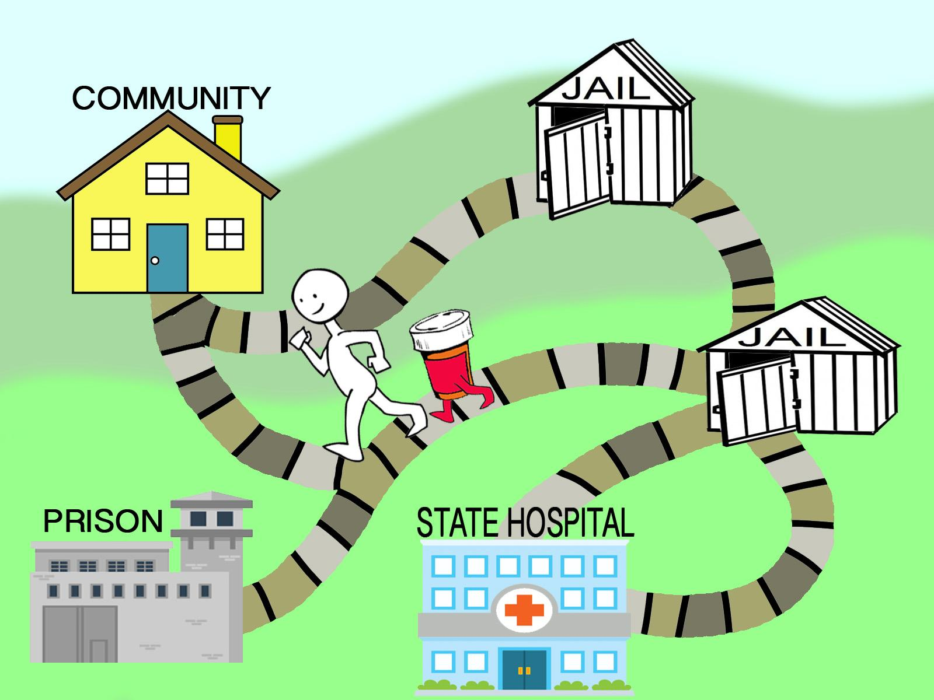
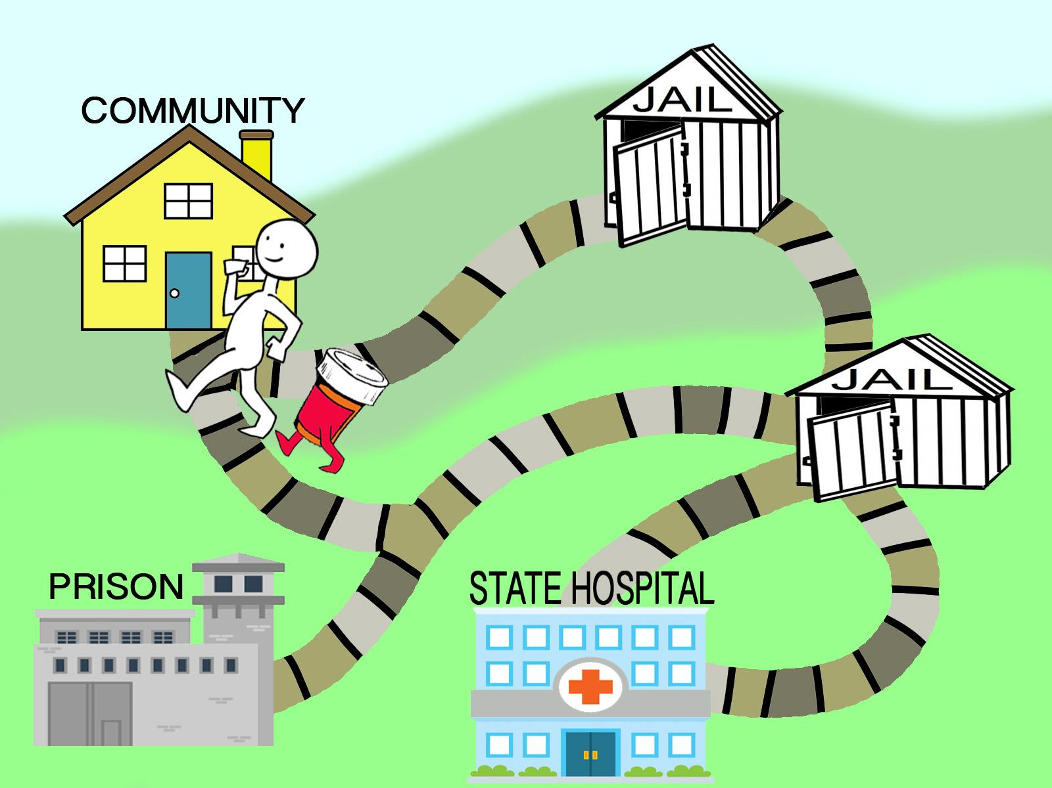
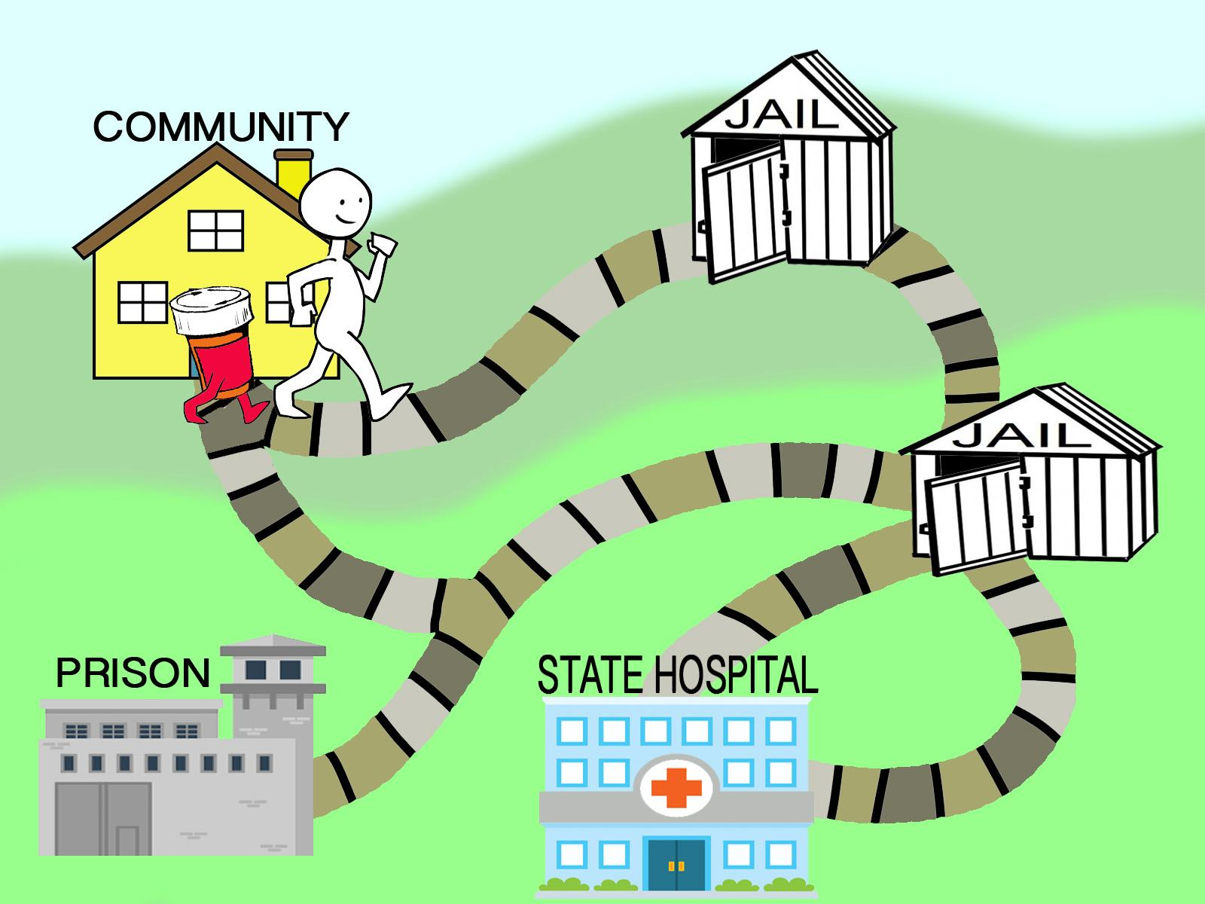

Slide 11
Solution
Create a required statewide formulary for providers who receive state funds
Coordinate with a wide array of stakeholders:
  The state Medicaid authority
  Health and Human Services organizations
    community mental health centers
    community substance use disorder providers
    youth corrections
    agency for persons with an Intellectual/Developmental Disability
  County Sheriffs (jails)
  Department of Corrections (prisons)
  Persons with lived experience

Slide 12
Should Be Easy, Right?
Challenges include the MET
  Money (funding)
  Ego (authority)
  Turf (autonomy)
Logistics of establishing a state Rx purchasing cooperative
  Home-grown versus use of an existing cooperative
Messaging
Gaining Buy-In, Promoting Adherence

Slide 13
The Purchasing Cooperative
Home-Grown vs. Existing
Minnesota Statutes 16C. 105, “any entity recognized by another state’s statutes as authorized to use that state’s commodity or service contracts…”
Colorado law does not prohibit participation in the Cooperative Purchasing Venture (CPV)
Complete a Membership Application Form
  Receive a Membership Permit Number and Security Code
Notes:
Would be challenging and time-consuming to create a Colorado-specific purchasing cooperative.
What about joining another state’s cooperative?
Counties, Cities and school districts, colleges are all members of the CPV. So why not our jails?

Slide 14

Notes:
For Jails it’s the purchasing cooperative and competitive pricing
For providers who receive state funds it’s a statutory requirement

Slide 15
Selecting the Formulary
Considerations
  Cost
  Demonstrated efficacy
  Med diversion potential
  Prevalence of use in the community
Established required and preferred meds for each medication class
  Did not employ step therapy algorithm
Getting the balance right
  Too broad and it’s costly and threatens adoption
  Too restrictive and it won’t achieve the goal
Notes:
Participants:
CMO of state Medicaid and the Department of Human Services,
Chief of Psychiatry for DOC,
Clinical Administrator for DYC,
Pharmacy Director for state Medicaid,
representatives from county jails and the Department of Public Safety
Persons with lived experience

Slide 16
The Path to Legislation
Laying the groundwork
The work of standing state committees that address mental health and criminal justice
Reaching out to legislators
Spreading the word
Eliciting buy-in (especially from county jails)
Creation of the bill SB17-019
Notes:
Process began in early 2015. The Medication Consistency Workgroup of the Behavioral Health Transformation Council spearheaded this effort under the leadership and direction of Regina Huerter.
The data sharing elements were the result of work done by the Legislative Oversight Committee of the Task Force on Mental Illness and the Criminal Justice System.

Slide 17
Elements of Colorado SB17-019
Promulgate rules requiring compliance:
  Office of Behavioral Health (OBH)
  Department of Corrections (DOC)
OBH to conduct annual reviews of the formulary
Participating providers required to share tx info
OBH to encourage participation in the purchasing cooperative
OBH and DOC to report on use of the formulary and the purchasing cooperative annually

Slide 18
Colorado SB17-019
Fiscal impact:
  $540,575 in FY2017-18
      $418,200 in Information Technology Services for Data Sharing
      $76,873 in Personnel (1.0 FTE)
      $24,000 for Consultant Services
  $126,057 thereafter
In Support of the bill:
  Colorado Dept. of Human Services
  Dept. of Corrections/County Sheriffs Association
  Tx of Persons with Mental Health Disorders in the Criminal and Juvenile Justice System
  Behavioral Health Transformation Council
  State Medicaid authority
Notes:
Office of Information Technology submitted a proposal that the Data Sharing element would cost $3M in FY2017-18 and $1.5M annually thereafter to create a centralized, secure database.

Slide 19
Clearing Misconceptions
The bill does not:
  mandate what a prescriber can and can’t prescribe
  directly affect the informed consent/medication decision process, which is highly individualized
  preclude a facility from having a non-formulary request or med pre-authorization system in place
The bill is designed to help guide prescribing practices by knowing which meds are likely to be continued as a patient crosses systems of care

Slide 20
The Path to Becoming Law-Senate
1/11/2017: Introduced in Senate, assigned to Judiciary
2/13/2017: Senate Judiciary refer amended to Approps.
5/5/2017: Senate Approps referred amended to Special Committee, which passed the bill that day
5/8/2017: Senate 3rd reading passed with amendments
5/10/2017: Senate considered House amendments and concurred.
5/18/2017: Signed by the President of the Senate
Notes:
Amended 2nd Senate reading: Engrossed to implement by 9/1/17 and remove the data-sharing database requirement
Amended 3rd Senate Reading Re-engrossed to implement by 12/1/17
2nd House Reading: Revised to reduce the fiscal note from
3rd House Reading: Re-revised to compel the Exec Branch to request the funds necessary for the program in its future budget.

Slide 21
The Path to Becoming Law-House
5/8/17: Introduced to the House, assigned to Health, Insurance and Environment
5/9/2017: Refer unamended to Appropriations.
5/9/2017: Refer unamended to House Cmte. on the Whole
5/9/2017: House 2nd reading, passed with amendments
5/10/2017: House 3rd reading, passed with amendments
5/18/2017: Signed by the Speaker of the House
Notes:
2nd House Reading: Revised to reduce the fiscal note from approx $125K to $26K
3rd House Reading: Re-revised to compel the Exec Branch to request the funds necessary for the program in its future budget.

Slide 22
Governor’s Letter to the Senate
June 6, 2017
“We are pleased with the bill’s statutory changes and its support for Coloradans with mental illnesses. On the bill’s policy merits, we take no issue. However, we have concerns regarding the bill’s cost and the late amendments that were added to this legislation.”

Slide 23
Governor’s Concerns
Independent fiscal impact analysis estimated a cost of $540,575 with 0.9 FTE and continued costs in future fiscal years
Amendments by the Legislature reduced the stated fiscal impact to $26,000 and 0.0 FTE
Language in the bill legislated future budget requests by the Administration to prioritize funds to accomplish the bill’s tasks.
“For these reasons, I allowed Senate Bill 17-019 to become law without my signature.”

Slide 24
Article 70
“Medication Consistency for Individuals with Behavioral or Mental Health Disorders in the Criminal and Juvenile Justice Systems.”
Critical that the state increase the likelihood that a broad spectrum of medications, including psychotropic medications, are available…regardless of setting or service provider
State can help ensure medication consistency and also decrease overall state costs through the use of a common and agreed upon medication formulary and cooperative purchasing

Slide 25
27-70-103, C.R.S.
By 12/1/2017, the Department of Human Services, in consultation with DOC, shall promulgate rules
Develop process for education and marketing
By 9/1 of every even-numbered year a CDHS must review the medication formulary for adequacy.
By 9/1/2018, CDHS shall develop a plan to share health information electronically.
Appropriated $26,000 for the program:
  $24,000 to CDHS for personal services
  $2,000 to CDHS to operating expenses

Slide 26
Next Steps
Re-convene the SMEs to determine what meds are required.
Promulgate State Rules compelling compliance
Assisting participants in joining the purchasing cooperative
Establish an audit schedule for those subject to the law.
Create work plan for education and marketing
Begin work to create the health information portal for state jails

Slide 27


Slide 28


THE NAMI NATIONAL CONVENTION 2017
ARLINGTON, VIRGINIA: THE Sequential Intercept Model and
CRIMINAL JUSTICE INNOVATIONS
Leslie Weisman, LCSW
Arlington Community Services Board/DHS
Behavioral Healthcare Division
CAPT. BRIAN m. BERKE, MS
ARLINGTON COUNTY POLICE DEPARTMENT
JUNE 30, 2017

Slide 29
Mental Health and Law Enforcement connections
Long history in Arlington County of mental health and law enforcement partnering – for more than 25 years Emergency Mental Health Therapists have worked closely with Arlington County Police Department – ride alongs, roll calls, recruit training, community based assessments
Police Captain is always assigned to act as a liaison between the Emergency Services staff and patrol officers – trouble shooting/real time feedback, working through difficult cases, understanding each other’s work
Notes:
LESLIE: Capt. Berke and I have worked in Arlington for 30 years and we have been part of a long history of collaboration between law enforcement and mental health staff. The collaboration began with Emergency Therapists doing ride alongs during their shifts with police, attending roll call regularly to get to know the officers, and working side by side during assessments and other interventions.
The police dept assigns a police captain to act as liaison to Emergency Services and this is hugely instrumental in troubleshooting around difficult cases and most importantly – giving feedback in real time, as cases are developing, to work through differences of opinion or differing approaches to mentally ill individuals. Many years ago I would say, “we mental health people don’t tell you cops who to arrest, and you shouldn’t tell us how to assess… “ but with the advent of CIT training and jail diversion efforts, we now find that police have lots of opinions, many very valid, around assessment and mental health staff have much to say about who is arrested and why. . So the tables have turned….

Slide 30
History of Arlington county Mental Health Criminal Justice Review Committee (MHCJR)
Committee started in May 2003 in an attempt to look at the process that seriously mentally ill (SMI) people go through in Arlington in terms of the criminal justice system
Where do these individuals fall through the cracks?
Where are new programming or stronger partnerships needed?
Notes:
BRIAN: In 2003 we brought together a large group of mental health and criminal justice partners in order to look at the high numbers of mentally ill in our jail and criminal justice system. We knew these individuals were falling through the cracks and staying in jail exponentially longer than the non-mentally ill. We decided to form a MH CJ Review Cmte to look at the needs and gaps in services in our County and to begin the partnerships that would ultimately lead to improved services. This cmte has now been meeting every month for 14 years.

Slide 31
Original Goals of MHCJR Committee
Review current mental health and county jail systems and processes for treating SMI
Make recommendations for system improvements to more effectively divert, treat and monitor persons with mental illness who become involved in the system
Create effective linkages for mentally ill persons as they leave the jail
Implement recommendations
Notes:
BRIAN: The original goals for the cmte were to review current systems and processes for serving justice-involved mentally ill. We knew it was equally important to look at why these individuals were being arrested as well as how they are being linked to services after incarceration.

Slide 32
Committee Membership
Behavioral Healthcare staff: forensic team, CIT Coordinator, jail based mental health staff, substance abuse staff, Emergency Services staff to include Certified Peer Specialist, senior management
Local NAMI representatives
Sheriff’s Department
Magistrate
Public Defender and Sentencing Advocate
Deputy Commonwealth’s Attorney
Police Department
Community Corrections
State Probation and Parole
General District Court Judge
Notes:
LESLIE: We have a wide array of staff and concerned citizens that join our mtg monthly. There is representation from the behavioral health side to include peer specialists, the law enforcement side, judicial system and community representation. People have continued to come every month which I think is due to the work that gets accomplished and the oppty to build relationships. There are many smaller, focused meetings that have splintered off to focus on areas such as Risk-Needs-Responsivity, specialty dockets, and bond diversion efforts.

Slide 33
Major accomplishments of mhcjr committee since ‘03
Year 3: Creation of Forensic Case Management/Jail Diversion team
Year 4: With state grants, hired a supervisor and Jail Discharge Planner
Year 5: Held 1st CIT training (January 2008)
Year 7: Began grant-funded Post-Booking Magistrate Project (2 Master’s level clinicians and a forensic peer specialist)
Year 8: Received grant to fund CIT Coordinator; co-located all “front door” programs as part of development of Crisis Intervention Center (CIC); started Project Exodus (partnership between probation officers, forensic peer specialist and clients to reduce Probation Violations and hospitalizations); began Magistrate CIT training
Year 11: Received grants to pay for security at CIC and Virginia Hospital Center to ensure safety and Transfer of Custody Process
Year 14: Began Bond Hearing Diversion Project; started Risk-Needs-Responsivity (RNR) “launch” – received grant for RNR Simulator tool and funding for Recreational Specialist for “pro-social” activities for offenders
Notes:
LESLIE: These are some of the major accomplishments over the 14 years: we received state funding for our jail diversion manager and jail discharge planner, we started CIT training in 2008, we received funding and started a Post-Booking Magistrate project in 2009, we received grant funding for our CIT Coordinator which eventually became a permanent county position, we received funding to pay for security officers at our Crisis Intervention Center and local hospital, we began a Bond Diversion Project, and this past year we launched a Risk-Needs-Responsivity initiative which looks at best practices related to mentally ill offenders.

Slide 34
Arlington County Sequential Intercept Model
Developed in 2006 by Mark Munetz, M.D. and Patricia A. Griffin, Ph.D. of the National GAINS Center for People with Co-occurring Disorders in the Justice System.
Addresses interface between criminal justice and mental health system.
Goal 1: Develop points of interception at which an intervention can be made to prevent individuals from entering or penetrating deeper into the criminal justice system.
Goal 2: Prompt access to treatment at every intercept.
Goal 3: Develop targeted strategies to increase diversion of people with mental illness from criminal justice system and link with appropriate community services.
Notes:
LESLIE: So---although Dr. Mark Munetz and Dr. Patty Griffin developed the Seq Int Model in 2006, we feel that in Arlington we were ahead of the curve in developing our version of the model starting in 2003. As many of you many know, the Seq Int Model is a model of conceptualizing how mentally ill people interface with the criminal justice system across 5 intercepts from encounters with the police at the 1st intercept to return to the community and working with probation on the 5th intercept. The goal, as we show you our map, is to have strategies and programming at every intercept in an attempt to stop or slow the penetration of the mentally ill into the CJ system and ensure linkages as these individuals re-enter the community.

Slide 35
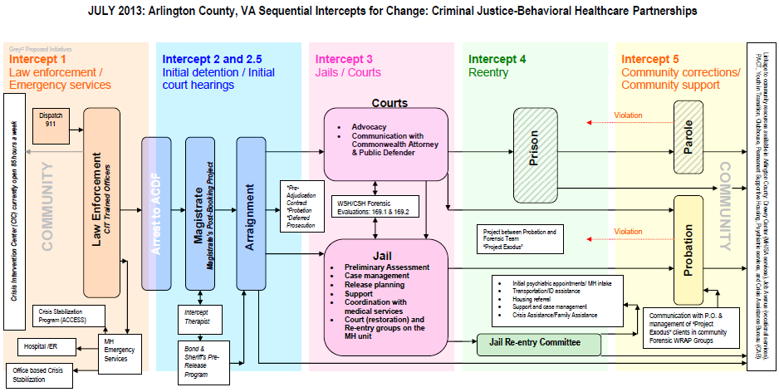
February 2016: Arlington County, VA Sequential Intercepts for Change’ Criminal Justice-Behavioral Healthcare Partnerships
Notes:
LESLIE: This is the Seq Inter Map for Arlington and we will look at it more closely shortly. As you can see visually, there is a lot going on at the 1st and 2nd intercept because that is where we put our energy and focus in hopes of avoiding or lessening length of incarceration for the people we serve.

Slide 36
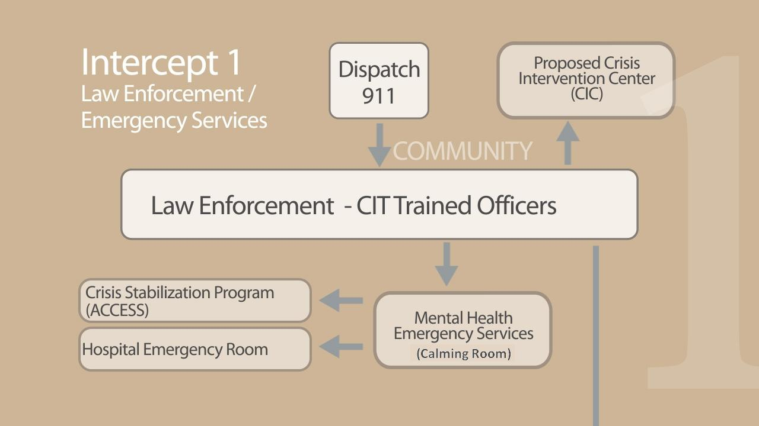

Crisis Intervention Center (CIC) open 24/7/365 with full time security
Crisis Stabilization Program (ACCESS)
Mental Health Emergency Services
Homeless Case Management Services
(Specialized Justice-Involved Programming)
Hospital/Emergency Room
Office Based Crisis Stabilization (23 hour)
Notes:
LESLIE: Very quickly, the first intercept is related to law enforcement and emergency services and their interactions in the community with the mentally ill. The goal is to provide CIT training to officers to offer the means for safer encounters with the mentally ill and just as important, a location to bring these individuals in lieu of arrest which is our CIC. We offer a spectrum of crisis services with involuntary hospitalization being the last resort.

Slide 37
Bridging the divide: the development of cit training in arlington
The partnership and trust between mental health and law enforcement along with the foundation built in the MHCJR, led to the development of CIT;
    Trust was established through ride alongs, attending roll calls, learning from each other without second guessing one another, joint training
Critical review of problematic aspects related to law enforcement with the mentally ill, i.e. length of time spent with the mentally ill individual, injuries to consumers, their family members, or law enforcement during interactions, improving officer skills in relating to individuals with behavioral health concerns
Natural progression to develop CIT – first training was in January 2008. It was only for recruits and it was 24 hours, not the required 40 hour training. By 2009 we were providing 2-3 40 hour trainings/year, in addition to training police dispatchers and magistrates
479 participants overall in CIT training thus far; 64% of current ACPD patrol officers and more than half of the jail’s deputy sheriffs
Notes:
BRIAN: As mentioned earlier, much relationship building went into our development of CIT. The program was launched in 2008 with police recruits and then a decision was made to give these officers some time on the streets prior to CIT training. For the deputies, we train them right out of the academy given that they go to work in the jail and at any given time 16-35% of the inmates have mental health issues. At this time we have trained 479 people from a wide variety of law enforcement agencies in Arlington as well as security officers, medics and fire personnel. Our goal is to train all street officers and all deputy sheriffs working in our detention center.

Slide 38
CIT TRAINING CURRICULUM – HIGHLIGHTS OF THE WEEK
MONDAY | TUESDAY | WEDNESDAY | THURSDAY | FRIDAY
History of CIT, Why you are here, & Overview of Training Objectives Clinical States Parts 1 and 2 Audio Hallucination Simulation Clinical States Part III Psychotropic Medications Special Populations: Children/Adolescents Special Populations: PTSD/TBI and War Veterans | Emergency Services Peer Recovery Services Community Resources NAMI & Family Perspective Consumer Perspective Site Visits Site 1: Clarendon Clubhouse Site 2: Northern Virginia Mental Health Institute Site 3: Arlington County Detention Facility Consumer & Officer Perspective | Basic Active Listening Techniques Basic Active Listening Exercises Self-Medication and Substance Abuse Suicide Prevention and Intervention Skills for CIT Officers Basic CIT and De-Escalation Techniques Basic Role Play Exercises | Cultural Diversity Mental Health Legal Training Intermediate Role Plays | Project Lifesaver REACH Special Populations: Autism . Legal Training: Jail Diversion . Course Review and Written Exam Advanced Role Play Exercises/Final Exam Course Wrap-Up and Certificate Presentation
Notes:
BRIAN: This is the CIT curriculum for our 40 hour training. You can see where it is underlined, some of the most interesting segments. These include the audio hallucination simulator, training on special populations to include children, adolescents, veterans and their challenges with PTSD and TBIs, and people with autism. We instruct participants on recovery and the role of peer specialists which is a very new concept for most officers. We also have families and officers share their experiences when they have encounters, positive or negative, with law enforcement. We do site visits to our clubhouse program, our local state psychiatric hospital and the mental health unit at our jail.

Slide 39
Crisis Intervention Center (CIC)
Unique co-location of multiple “front door” programs at one location:
      Emergency Mental Health Services
      Jail Diversion/Forensic Case Management
      Discharge Planning
      Homeless Outreach/Case Management
      Assessment & Intake Services
CIC operates 24/7/365; range of Emergency Mental Health Services provided by Emergency Therapists and Certified Peer Specialists
Security around-the-clock from private security company with legally sanctioned Transfer of Custody process at CIC and at local hospital
All hospital and CIC security officers are CIT-trained
Notes:
LESLIE: part of what makes our CIC unique is the co-location of several “front door” programs to include ES, jail diversion/forensic case mgmt., dcpl, homeless outreach, and intake services. Many staff are cross-trained to assist in ES. We operate 24/7/365 as required by state code and our staffing includes 2 full time certified peer recovery specialists. They are actively involved in all aspects of ES work with exception of clinical assessments and risk assessments. Their addition has made a huge difference in our programming.

Slide 40
Assessment Process
Police contact Emergency Therapists from the field to determine the appropriate location for the assessment – the CIC is generally for less acute dispositions vs. the Emergency Department which is usually for people in need of hospitalization or immediate medical care
At the CIC we provide a range of crisis intervention services:
      Warm hand off to clinicians for immediate assessment
      Evaluation and Counseling (includes Transfer of Custody from police to security officers)
      Office-Based Crisis Stabilization (“23 hour bed”)
      Referral to Residential Crisis Stabilization
      Facilitation of Hospitalization
Use of “calming rooms” where people can remain comfortable for extended periods of time
Psychiatrist and Psychiatric Nurse Practitioner on duty Monday - Friday
Notes:
LESLIE: Our process in Arlington is for police to call ES staff from the field when they encounter a person having a behavioral health crisis. We decide together whether the person is best served at the CIC or if the person needs to go directly to the hospital. Our range of services includes phone triage and support, assessments and crisis intervention, OBCS (which is 23 hour bed essentially), we refer to residential crisis stab and we facilitate voluntary and invol hosp. we have 30 hours of prescriber time.

Slide 41
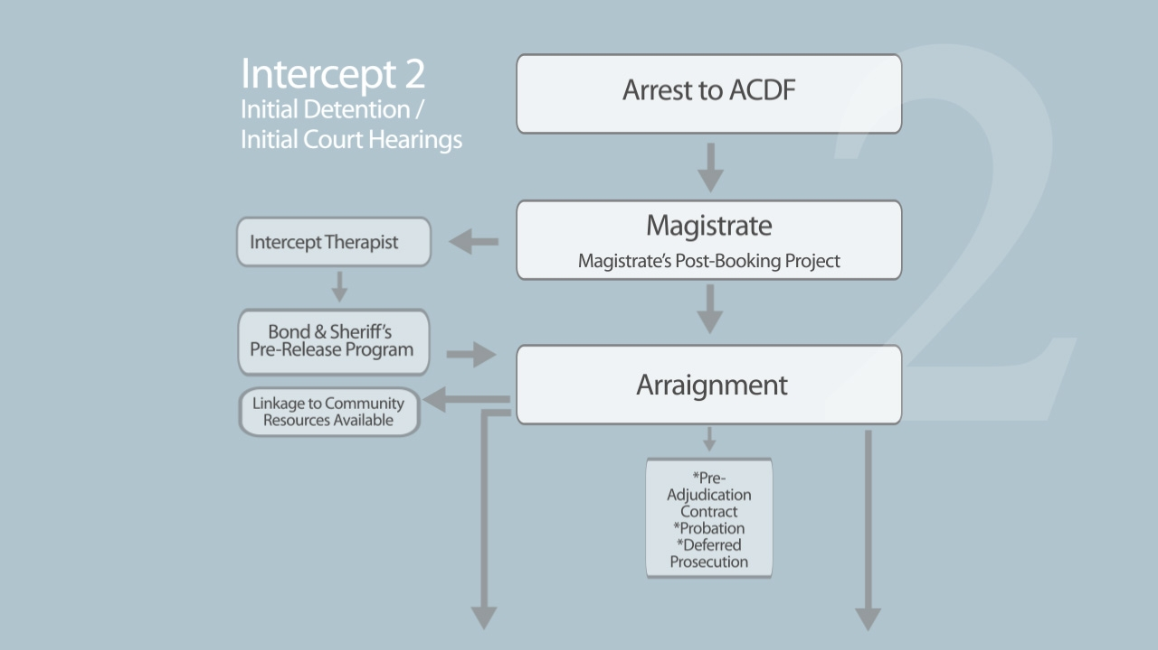
&2.5
Intercept Therapist/
Boundary Spanner
Bond & Sheriff’s
Pre-Release Program
(Bond Hearing Diversion Project)
Notes:
LESLIE: intercept two is primarily focused on our PBMP and Bond Diversion project. These are both strategies for diverting people from jail and/or shortening their stay.

Slide 42
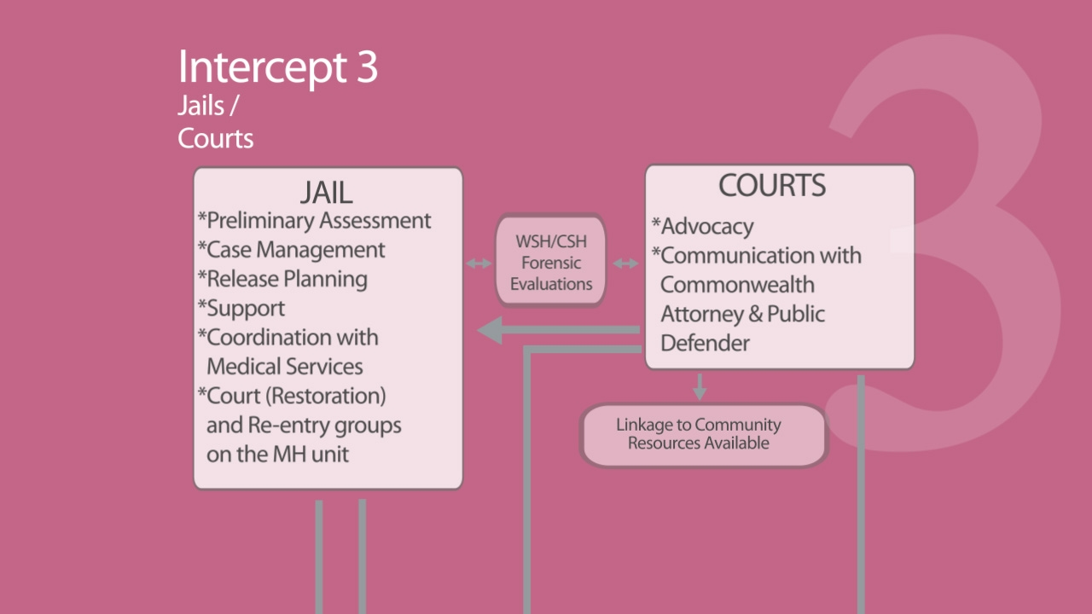
Notes:
LESLIE: The 3rd intercept focuses on services within the jail. We provide groups, individual counseling, restoration to competency services, and crisis intervention.

Slide 43
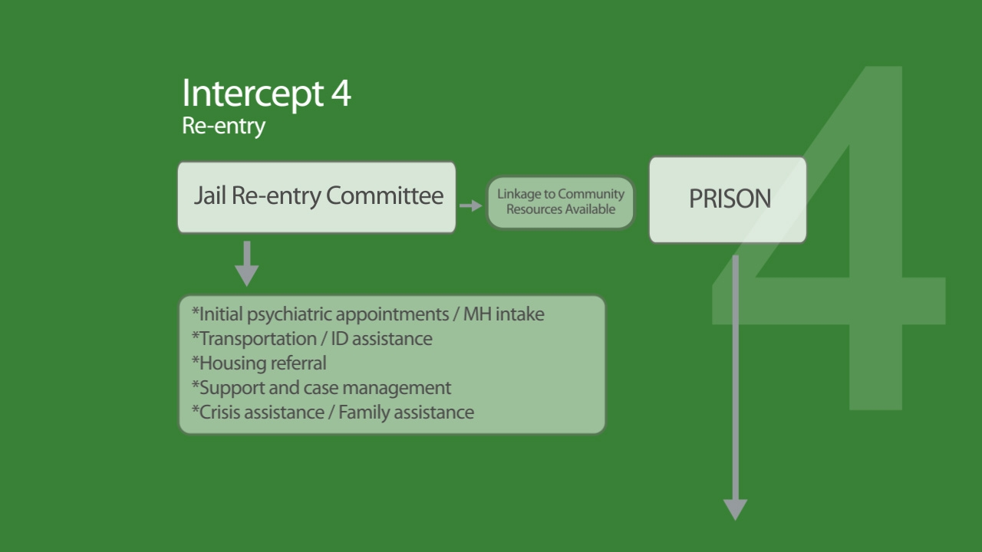
“Project Exodus”
Partnership between Probation
and Forensic Team
Notes:
LESLIE: THE 4TH intercept relates to preparation for re-entry into the community. We have a multi-agency re-entry cmte which looks at mentally ill inmates who are 90 days out from release and they begin to plan for these individuals. We also provide in-reach by our homeless team to begin to serve these people. Our Project Exodus is a program designed to focus on mentally ill offenders on probation. They are high risk for probation violations so we partner with the client and their POs to help the client understand the conditions of their probation and to help the POs to understand the mental health challenges of these clients and how that affects their status on probation.

Slide 44
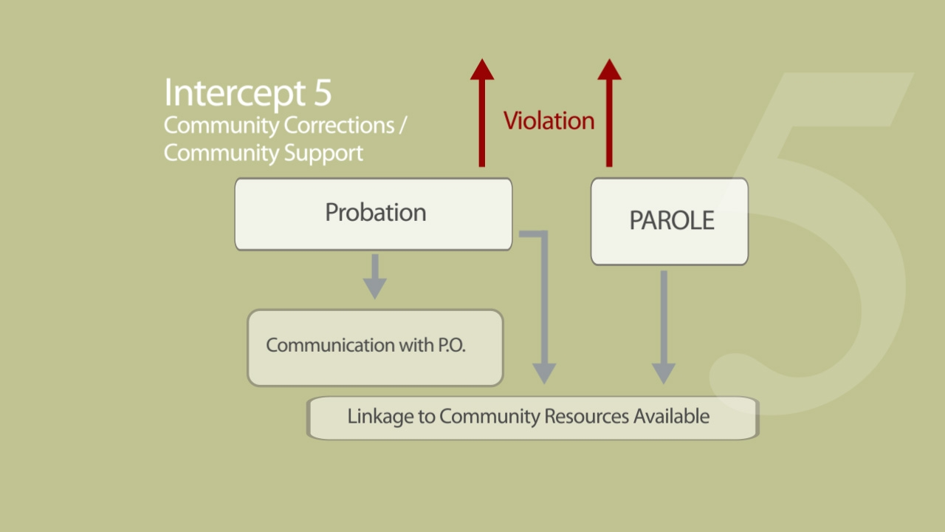
Communication with P.O. and management of Project Exodus clients in the community
Forensic WRAP (F-WRAP) groups
Notes:
LESLIE: 5th intercept is entry into community. This is where we provide clinical services and hope to keep our clients from recidivating.

Slide 45
Data and Outcomes

Slide 46
Individuals served in lieu of arrest
Number of clients brought to Emergency Services in lieu of arrest has increased every year since inception of CIT in Arlington in 2008;
In 2008: 55 individuals/year brought to Emergency Services in lieu of arrest;
In FY17 number has doubled;
Post-Booking Magistrate diversions add an additional 50-55/year.
Notes:
LESLIE: We have noticed since the start of CIT and the PBMP, that there are steadily growing numbers of people being brought to our CIC in leiu of arrest. We certainly haven’t stemmed the tide of arrests but we are making good progress. We do have a process in place where we do an “autopsy,” so to speak, of any arrests of SMI people to look at whether the arresting ofcr was CIT trained, was the individual symptomatic when arrested, did the magistrate note any mh issues, and are there training needs to address.

Slide 47
Training of law enforcement personnel
YTD 64% of Arlington County Police have been CIT trained, over half of Deputy Sheriffs, and Pentagon Police, Airport Police, and other local law enforcement agencies
Notes:
BRIAN: This is data on the number of Arlington County officers trained and their confidence level in dealing with people in crisis after receiving CIT trng. We have trained over 64% of our patrol officers. Our officers are extremely satisfied with the training and definitely feel they are more confident with their knowledge of mental health issues after CIT trng.

Slide 48
Transfer of custody
Transfer of Custody began September 2013
50% reduction in time spent by officers with clients in crisis
Notes:
BRIAN: (self-explanatory) officers are saving hours by having the TOC process in place. This allows for a legal transfer of custody of a mentally ill person from the officer who took them into custody to the CIT trained security officers at the CIC or at the hospital. This transfer process is available to our police, sheriff’s department and airport officers.

Slide 49
Contact Information
Leslie Weisman, LCSW – Arlington County Behavioral Healthcare Division; Email: Lweism@arlingtonva.us; Phone: 703-228-4888
Captain Brian M. Berke, MS – Arlington County Police Department; Email: bberke@arlingtonva.us; Phone: 703-729-4299 x112

