Slide 1
Strategic Social Media

Slide 2
Why Social Media?
Foster and engage with community
Build relationships beyond normal interactions
Social media usage continue to rise

Slide 3
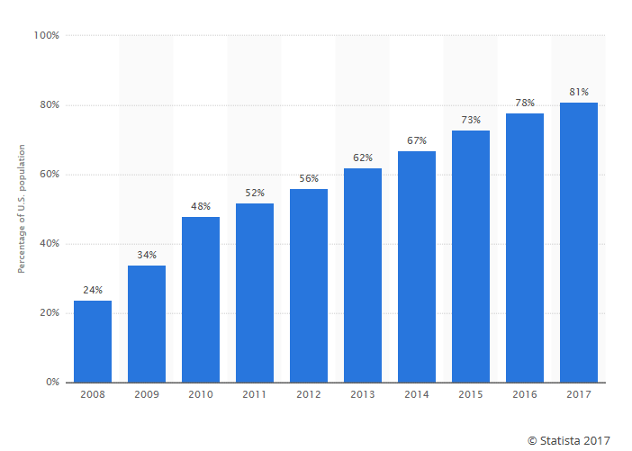
Percentage of Americans Using Social Media

Slide 4
Platforms
79% of online users (8 in 10) use Facebook
68% of US adults
24% of online users (8 in 10) use Twitter
21% of US adults
32% of online users (one-third) use Instagram
28% of US adults
18% of online users (41% 18-34) use
Snapchat - 15% of US adults

Slide 5
General Best Practices
Twitter
Practice writing complete thoughts in 140 characters or less
Don’t push updates from Facebook to Twitter
Retweet and engage
Facebook
Use a Business Page not a personal profile
Have a plan for content
Boost posts
Get Live!

Slide 6
General Best Practices
Share your “Story”
Be engaged
--Like & comment
--Follow similar users
--Repost quality content
Instagram
Pick a filter and stick with it
Find the best hashtags and use them correctly
Be consistent, 1 to 3 posts per day

Slide 7
Amplify a Singular Message Across Platforms

Slide 8
Let’s Look At Some Examples

Slide 9
NAMIWalks Virginia - Facebook

Slide 10
NAMIWalks Virginia - Instagram

Slide 11
NAMIWalks Virginia – Twitter

Slide 12
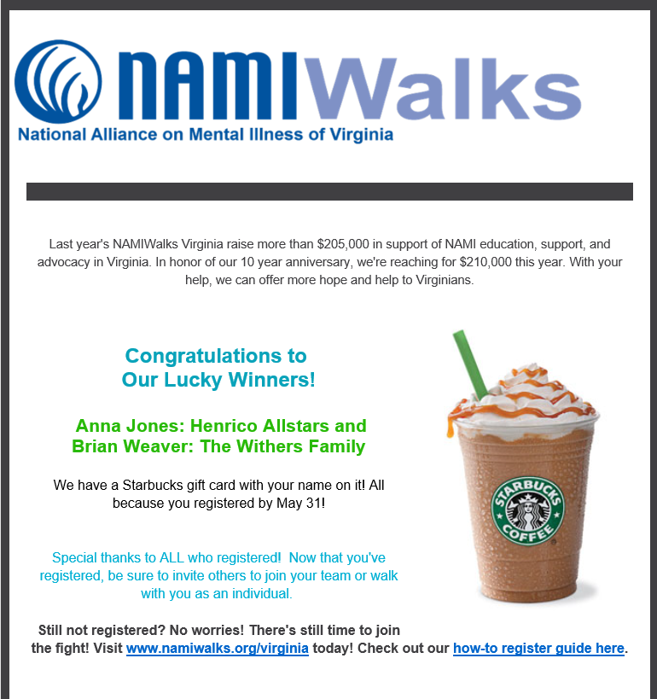
NAMIWalks Virginia – Email

Slide 13
NAMIWalks Virginia
How could they have used
Or
?

Slide 14
NAMIWalks Greater Philadelphia

Slide 15
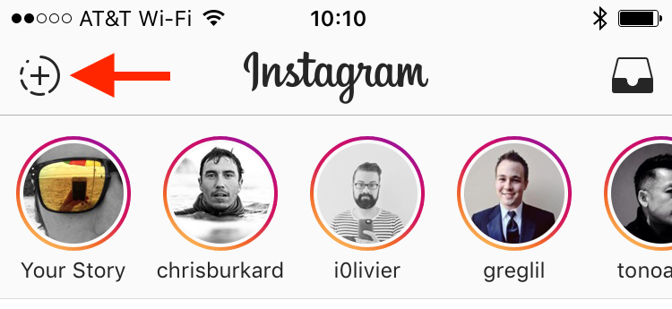
Instagram Stories

Slide 16
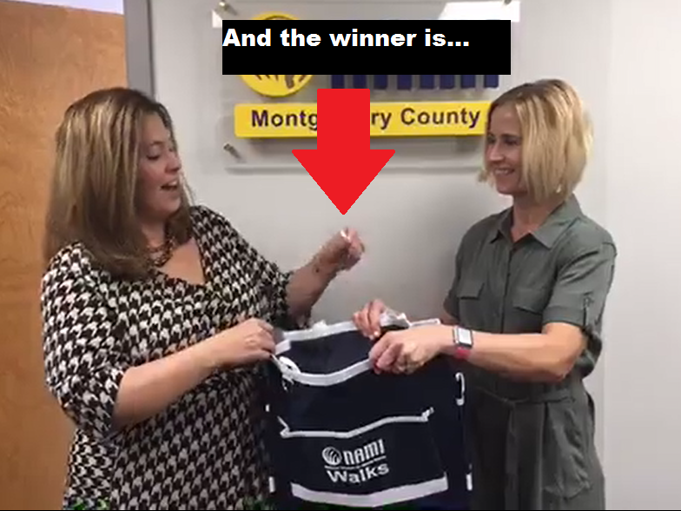
NAMIWalks Greater Philadelphia

Slide 17
Add Variety to your Messaging

Slide 18
NAMIWalks Washington
Focus on
a Goal

Slide 19
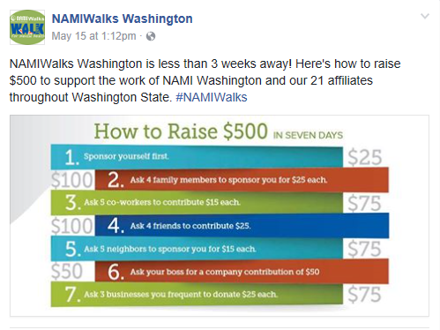
NAMIWalks Washington
Give
“How To” Advice

Slide 20
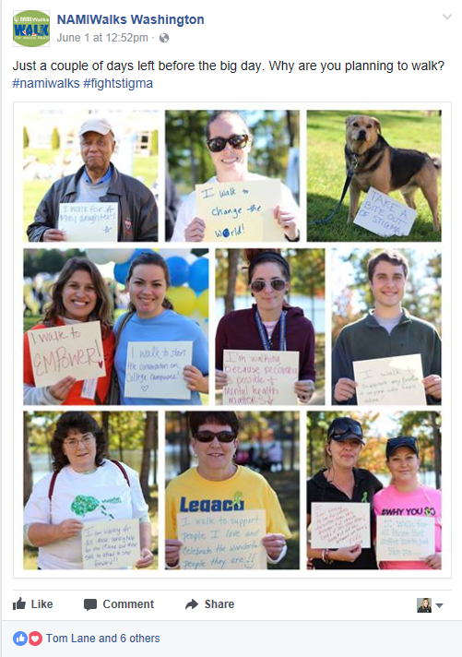
NAMIWalks Washington
Get to the Heart of your Message

Slide 21
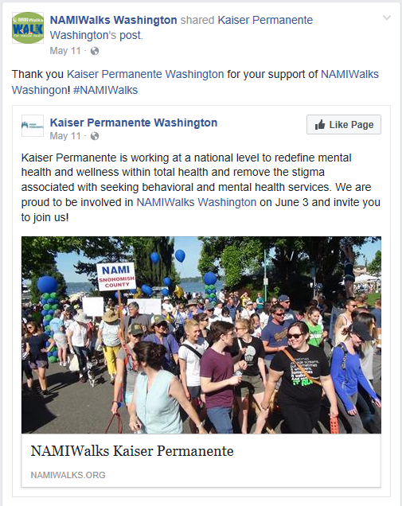
NAMIWalks Washington
Highlight a Sponsor

Slide 22
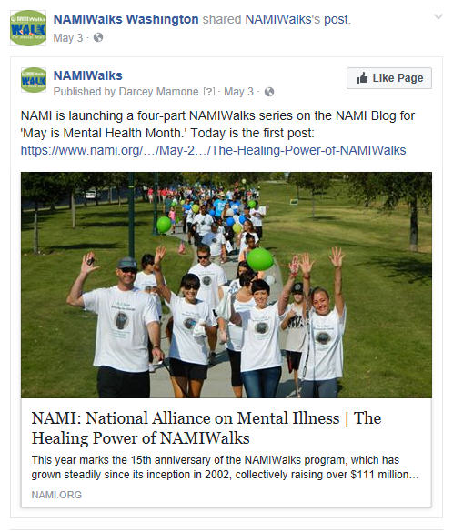
NAMIWalks Washington
Share other NAMI Posts

Slide 23
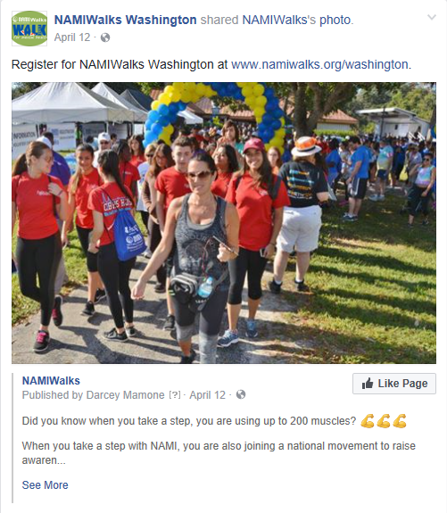
NAMIWalks Washington
Incite People to Action

